Slide 1
K–6 advice to support curriculum implementation
Advice for NSW primary schools

Slide 2
K–6 advice to support curriculum implementation
Time allocation advice for K–6 syllabuses supports teachers and schools to maximise teaching and learning time in a school day, term and year when implementing the curriculum. The allocation for optional Languages syllabuses and/or other activities provides schools with the opportunity to incorporate activities reflective of their school’s context.
Examples may include additional time for selected learning areas or Languages, assemblies, debating, ethics, religious education, sport and pastoral care. Schools may also need to consider the policies of their sector and school context.

Slide 3
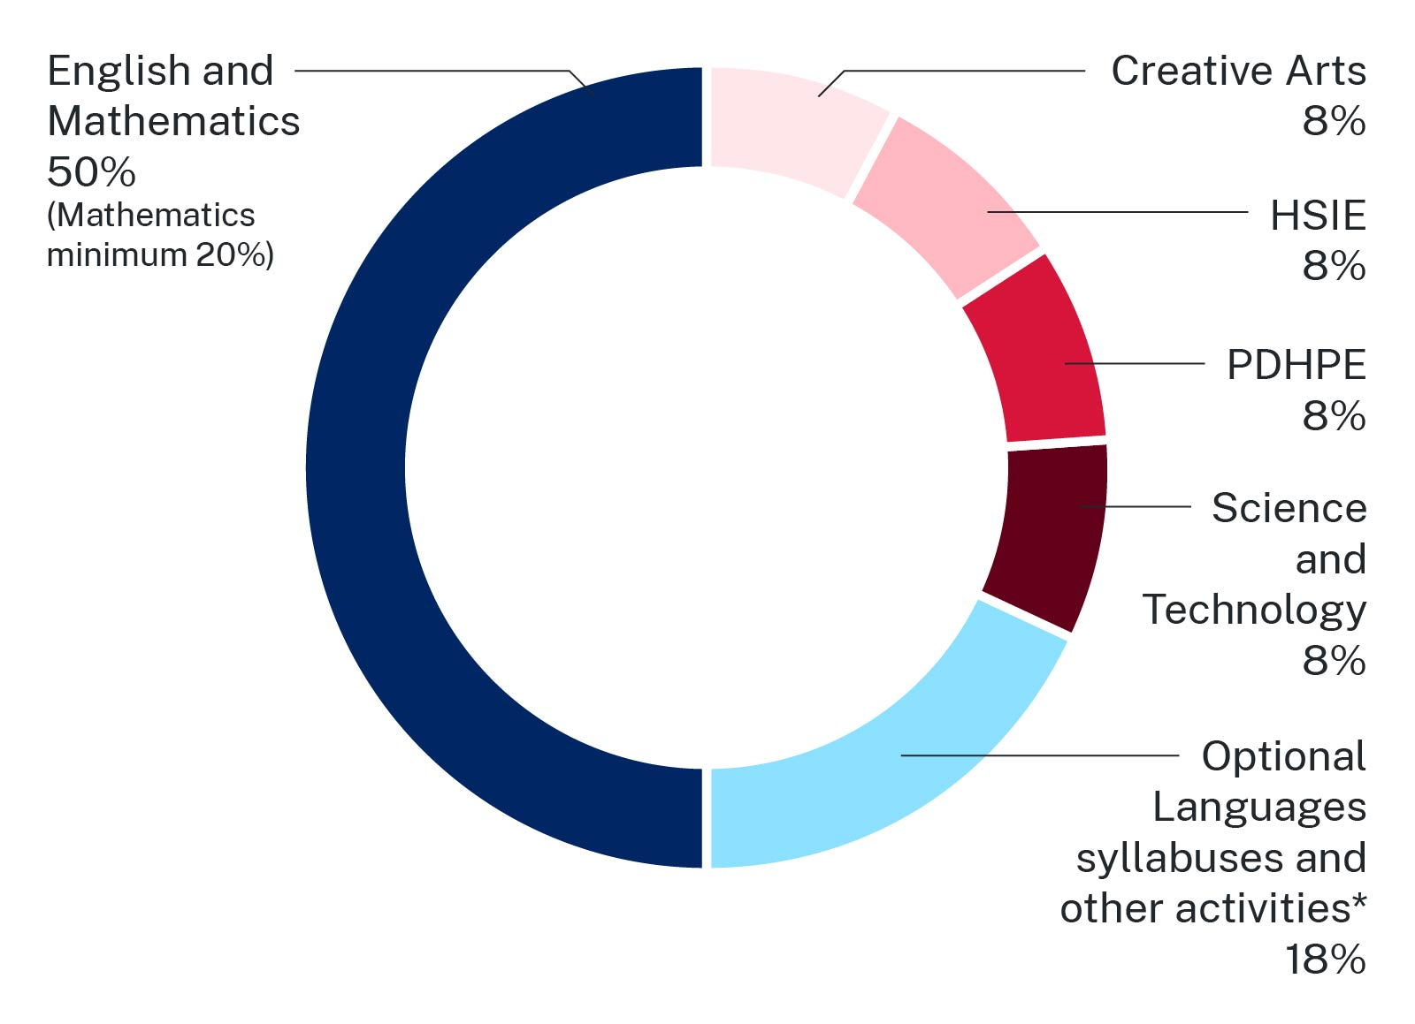
Allocating time for implementing the K–6 curriculum
Schools can use this time allocation advice to guide them in K–6 curriculum implementation decisions.
* Optional activities may include additional time for selected learning areas or Languages, assemblies, debating, ethics, religious education, sport, pastoral care and other school or sector requirements.
Figure 1: K–6 time allocation advice across learning areas to support curriculum implementation
Image long description: A graph representing advice on the time allocation for all K–6 learning areas. This includes 50 per cent of total time for English and Mathematics (with a minimum of 20 per cent for Mathematics). Creative Arts, HSIE, PDHPE, Science and Technology each have 8 per cent of total time. Optional Languages syllabuses and/or other activities have a recommendation of 18 per cent total of teaching and learning time.

Slide 4
Allocating time for implementing the K–6 curriculum
Support for school leaders and teachers

Slide 5
Support for school leaders
The time allocation advice for K–6 provides schools with the opportunity to consider their use of time for maximum impact on student learning. School leaders can use the following reflection questions to support curriculum implementation decisions.
To what extent do our current practices reflect the time allocation advice to meet the needs of our students, and any sector requirements?
What effect do our current time allocations have on student learning?
How will we support our staff to consider the time allocation advice in their planning for learning?
Is there an opportunity to modify our time allocations to maximise learning opportunities?
What do we need to consider in our use of the optional Languages syllabuses and/or other activities time? For example, should we allocate additional time for a particular learning area or another activity?
To what extent are we using our optional Languages syllabuses and/or other activities time to meet the needs of our students, and sector requirements?

Slide 6
Support for teachers
The time allocation advice for K–6 syllabuses provides schools with the opportunity to consider their use of time for maximum impact on student learning. Teachers can use these reflection questions to support curriculum implementation decisions that best meet the needs of their students.
To what extent does my class timetable reflect the time allocation advice and support student learning?
How do I to maximise teaching and learning time in each day, term or year?
How will I collaborate with colleagues to plan our allocation of time?
Who can support me to ensure my time allocation best suits the needs of my students and school?
How do I use the optional Languages syllabuses and/or other activities time to maximise learning for all my students?

Slide 7
Support for school leaders and teachers Based on a 25-hour teaching and learning week
Allocating time for implementing the K–6 curriculum
The following slides show examples of percentages from the time allocation advice for K–6 in hours. These calculations are based on an example of a 25-hour week with a 5-hour teaching and learning day across a 10-week term. Some schools may have fewer weeks per term and longer teaching and learning days. Schools can use these examples in conjunction with the reflection questions to support decisions about maximising student learning in the implementation of the K–6 curriculum.
All times are approximate.
Notes:
The following slides show examples of percentages from the time allocation advice for K–6 in hours based on a 25-hour week or 5-hour teaching and learning day over a 10-week term.

Slide 8
A practical example of percentages represented as hours Based on a 25-hour teaching and learning week over a 10-week term
Time allocation period
Teaching and learning time*
English and Mathematics
Creative Arts
HSIE
PDHPE
Science and Technology
Optional Languages syllabuses and/or other** activities **
Week
25 hours
12.5 hours total each week
2 hours each week for each learning area
4.5 hours each week
Term (approximately 10 weeks)
250 hours
125 hours total each term
20 hours each term for each learning area
45 hours each term
Year
(250 hours x 4 terms)
1000 hours
500 hours total each year
80 hours each year for each learning area (320 hours total)
180 hours each year
* Some schools may have more hours in a week and fewer weeks in a term.
** Optional Languages syllabuses and/or other activities. Examples may include additional time for selected learning areas or Languages, assemblies, debating, ethics, religious education, sport, pastoral care and other school or sector requirements.
Figure 2: Example of time allocation for a 5-hour day or 25-hour teaching and learning week over a 10-week term
Notes:
Allocating time for implementing the K–6 curriculum
This and the following slide show examples of percentages from the time allocation advice for K–6 represented in hours. This slide shows an example of percentages from the time allocation advice for K-6 in hours based on a 25-hour week or 5-hour teaching and learning day over a 10-week term. Schools can use this advice in conjunction with the reflection questions to support decisions about maximising student learning when implementing the K–6 curriculum. Some schools may have fewer total weeks and longer school days, or more weeks with shorter days. Schools can consult the relevant registration and compliance information for their context.
All times are approximate.

Slide 9
A practical example of percentages represented as hours by stage Based on a 25-hour teaching and learning week over four 10-week terms
The time allocation advice can be represented across a stage as an overview of the number of hours of teaching and learning in a 5-hour day and 25-hour teaching and learning week*.
Early Stage 1
Stage 1, Stage 2 and Stage 3
English and Mathematics
Stage approximately 500 hours (1 year)
English and Mathematics
Stage approximately 1000 hours (2 years)
Creative Arts 80 hours
1 year for each learning area approximately
320 hours
Creative Arts 160 hours
2 years for each learning area approximately
640 hours
HSIE 80 hours
HSIE 160 hours
PDHPE 80 hours
PDHPE 160 hours
Science and Technology 80 hours
Science and Technology 160 hours
Optional Languages syllabuses and/or other activities**
Stage approximately 180 hours
Optional Languages syllabuses and/or other activities**
Stage approximately 360 hours
Overall stage total teaching and learning time (approximately) 1000 hours
Overall stage total teaching and learning time (approximately) 2000 hours
* Some schools may have more hours in a week and fewer weeks in a term.
** Optional Languages syllabuses and/or other activities. Examples may include additional time for selected learning areas or Languages, assemblies, debating, ethics, religious education, sport, pastoral care and other school or sector requirements.
Figure 3: Example of stage breakdown of allocation of hours across a 25-hour teaching and learning week
Notes:
Percentages as hours per week
The time allocation advice representing percentages as hours can be used in conjunction with the reflection questions to support curriculum implementation decisions. These calculations are based on a 25-hour week with a 5-hour teaching and learning day over a 10-week term. Schools can use this advice in conjunction with the reflection questions to support decisions about maximising student learning when implementing the K–6 curriculum. Some schools may have fewer total weeks and longer school days or more weeks with shorter days. Schools can consult the relevant registration and compliance information for their context.
All times are approximate.

