Slide 1
Fundamental movement skills (FMS)
Sample physical activities and games
Personal Development, Health and Physical Education K–6 (2024)

Slide 2




Resource overview
This teaching resource supports teachers’ understanding of teaching the focus area: Movement skill and physical activity, in the NSW PDHPE K–6 Syllabus (2024) with sample physical activities and games that support the teaching of the fundamental movement skills (FMS). The suggested games and physical activities are designed to support cooperation, teamwork, fair play and high levels of participation for all students. They also support the development of oral language and communication skills.
In Stages 2 and 3, elements of target, net and court, striking and fielding, and territory games are taught, drawing on components that feature in many sports that are played in Australia.
Safety considerations
When planning to teach any physical activity or game, ensure that the activity is appropriate for the age, maturity and physical abilities of the students. Check that the playing area, equipment and the weather conditions are suitable for the activity.
Before teaching any physical activity, please consider:
adequate sun protection e.g. hats and shaded areas as much as possible
regular opportunities to drink water
access to necessary medications, e.g. for asthma and anaphylaxis.
Teachers should have access to a mobile phone in the event of an emergency.
Equipment must be regularly checked to ensure it is safe and in good working order. Playing area boundaries should be clearly identifiable using cones or something similar, and the playing area should be free from any dangerous objects or conditions, such as a wet and slippery ground.
Slides for teachers are blue and are hidden.
Slides that can be used with students are white and are not hidden.
The grass icon indicates that the activity can be played on a soft surface.
The asphalt surface icon indicates that the activity that can be played on a hard surface.
The sample physical activities and games in this resource align to the Sample whole-school curriculum plan found in the Teaching and learning support tab on the syllabus page.
Schools can use these sample physical activities and games in their teaching and learning sequences.
NSW Education Standards Authority

Slide 3

Fundamental movement skills
What are fundamental movement skills?
Fundamental movement skills (FMS) are a specific set of gross motor skills that involve different body parts. Students are introduced to FMS as the ‘building blocks’ for more complex skills that support lifelong participation in a range of physical activities and games..
Why are they important?
As students grow, they need instruction and practise to support the development of a range of motor skills with increasing control, coordination and purpose. Teaching FMS explicitly, and providing multiple opportunities to practise, builds competency and lays the foundations for more complex movement skills that are required in games and modified sport. FMS are important for individuals of all abilities. Learning and practising FMS with appropriate adjustments and support promotes confidence, competence and independence.
Vocabulary
The PDHPE K–6 Syllabus (2024) is designed to be coherent and is carefully sequenced to build subject-specific vocabulary and rich background knowledge. Each FMS, physical activity and game includes suggested vocabulary to support teachers’ explicit instruction.
Aboriginal and Torres Strait Islander Priorities
Content in this focus area reinforces the importance of developing FMS through diverse movement opportunities. Aboriginal and Torres Strait Islander physical activities and games always carry a significant Cultural purpose. Creating opportunities for students to practise and consolidate FMS through Aboriginal and Torres Strait Islander games and physical activities deepen students’ appreciation of Aboriginal and Torres Strait Islander Cultures.
This icon represents the Cultural wellbeing, identity, belonging, kinship, connection and Community.
The child is at the centre of Cultural wellbeing and supported by their mob. The beige wavy line represents kinship which is an interconnecting bond that is strong. The outer ochre circle represents the diverse Communities a child may belong to. Artwork by Paige Coe
Connected syllabus content
Making connections to other learning areas provides opportunities for students to deepen and enrich their learning and understanding. An example of this is in the Dance focus area in the Creative Arts K–6 Syllabus. Students perform locomotor and non-locomotor movements in response to stimuli, develop sequences of movement to tell stories, and form body shapes and change the level or direction of movements with control.
NSW Education Standards Authority

Slide 4
Fundamental movement skills teaching and learning
Students benefit when new content is explicitly taught, connected to prior knowledge and is broken down into manageable ‘chunks’. The new learning can then be practised, applied and innovated upon in different contexts.
Chunking and sequencing is when the teacher arranges and organises content into a learning sequence that builds students’ understanding over time. This supports students working or short-term memory as only small amounts of information can be held at one time. Teachers make decisions about the level of challenge and support for their students as they need many opportunities to practise new learning. Checking for understanding during the learning sequence allows teachers to make decisions about student learning and provide well-timed support.
When planning for learning:
1. communicate clearly the learning goals for the lesson, connecting the new learning to what the student already knows. Demonstrate and explain new content using clear examples and modelling of the sequence, step-by-step. This is referred to as ‘I do’. Connecting new knowledge to what students already know, understand and do, helps build their schema.
  For example, model and demonstrate the components of the catch, prompting students to ask and answer questions.
  2. Guide the students to practice the new learning, providing immediate and corrective feedback. Move forwards and backwards between demonstrating, modelling and supporting students to independence. This is referred to as ‘We do’. Students practise and apply their developing understanding many times.
  For example, students practise catching a ball, focusing on the positioning of their hands. Provide timely feedback and instruction, and when required, model the components of the catch again.
  3. Provide opportunities for students to independently demonstrate their understanding by explaining, justifying, applying and innovating on the learning in different contexts. This is referred to as ‘You do’.
  For example, the students play a throwing and catching game continuing to provide constructive feedback and check for understanding.

Slide 5
Fundamental movement skills support all
students
All bodies are diverse and move in different ways. Some students may require adjustments to engage with movement skills and physical activity. Additional teaching advice is available to support inclusive and accessible movement in the Teaching and learning support tab.
Complementary content for students with physical disability
Complementary content in the PDHPE K–6 Syllabus (2024) has been provided to enable some students with physical disability to develop movement skills, focusing on ability. Teachers can use the complementary content in combination with the content for fundamental movement skills (FMS) to meet the needs of individual students. The following flow chart illustrates the decision-making process that should be considered when teaching FMS.
Access content points
Access content points are used to support students with significant intellectual disability who are working towards Early Stage 1 outcomes. Teachers may use the access content points on their own or in conjunction with the Early Stage 1 content when teaching FMS.
All decisions about curriculum options for students with disability should be made in the context of collaborative curriculum planning.
Teaching advice
Teaching advice to support schools and teachers implement the Movement skill and physical activity focus area are here: Early Stage 1, Stage 1 ,
Stage 2 and Stage 3.
Online professional learning
Professional learning for the PDHPE K–6 Syllabus is available at NESA Learning.
Fundamental movement skills content
Consider relevant adjustments to ensure access and participation
Select from the complementary content to address individual movement goals

Slide 6
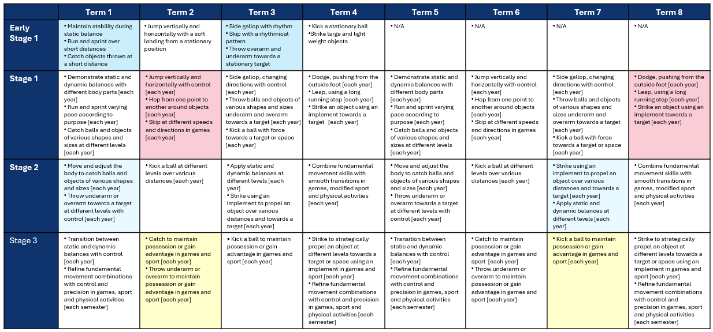
Sequencing fundamental movement skills content
The coloured boxes indicate the content addressed in this resource. This aligns to the Sample whole-school curriculum plan and the Sample scope and sequence: Early Stage 1 to Stage 3 found in the Teaching and learning support tab on the syllabus page.

Slide 7

Teaching fundamental movement skills with adjustments
Examples of adjustments that can be made to ensure access and participation in fundamental movement skills.
Fundamental movement skill | Adjustments to equipment and/or environment to support the development of the fundamental movement skill
Static and dynamic balance | Use a wider base of support and footprints or markers to guide foot placement. Perform the balance activity on a firm, flat surface. Provide a visual prompt on a fixed spot at eye level to support concentration. Use a handrail, wall or assistive devices as support.
Sprint | Focus on one part of the movement at a time: arm movement (straight, fast, forward-backward motion), leg drive (high knees, fast turnover), body position (lean slightly forward, eyes ahead). Then begin to combine the parts. Position cones or markers to give clear start and end points. Use progressions: march then jog then sprint in short distances. Use assistive devices such as wheelchairs, walkers, crutches, running frames, running poles or prosthetics. Guide a person through a guidewire, voice, or by holding some fabric or the person.
Vertical jump | Use a reachable target, such as hanging ribbon, balloon or paper streamer. Start with small jumps, slightly lifting feet off the floor. Use a soft surface, such as a gym mat to reduce impact on landing. Hold onto a low bar, rail or partner for assistance with balance. Practice bending knees and swinging arms first, then practice soft landing separately before combining. Use a therapy ball or mini trampoline with a stabilising bar.
Catch | Use items that move slower and are easier to track and hold, such as balloons, scarves, bean bags or soft foam balls. Catch a ball after it bounces or rolls to reduce speed and build hand-eye coordination. Use two-handed catches against the body. Practice in a seated position for better trunk stability. Use audible balls to track the sound to determine the direction or speed of an object.

Slide 8
Teaching fundamental movement skills with adjustments
Examples of adjustments that can be made to ensure access and participation in fundamental movement skills.
Fundamental movement skill | Adjustments to equipment and/or environment to support the development of the fundamental movement skill
Hop | Hold onto a wall, rail, rope or a partner for balance. Use progressions: small jumps on 2 feet then lifting one foot to introduce hopping. Use a soft surface, such as a gym mat, to reduce impact on landing.
Side gallop | Begin by stepping to the side and bringing the other foot in, start slow and increase speed. Use markers on the ground to guide where to place feet. Use music to guide timing and rhythm. Use environmental support or assistive devices for balance and coordination.
Skip | Use markers on the ground to step and hop into. Use streamers or ribbons to encourage rhythm and arm movement. Use progressions: walk through the movements then skip on the spot then skip moving forwards. Use a heavy-weighted rope or assistive devices, such as cordless skipping rope with weighted balls.
Throw | Practise each step individually then combine them one at a time. Use equipment that is easy to handle, such as bean bags, soft foam balls or light scarves. Use large, colourful or audio targets. Use progressions: throw at close range, underarm throw, two-handed chest pass or stationary targets then longer distance, overarm throw or moving or smaller target. Use visual markers, such as tape or mats, to show where to position self.

Slide 9
Teaching fundamental movement skills with adjustments
Examples of adjustments that can be made to ensure access and participation in fundamental movement skills.
Fundamental movement skill | Adjustments to equipment and/or environment to support the development of the fundamental movement skill
Kick | Practise each step individually then combine them one at a time. Use large, light, coloured or soft balls. Use coloured balls or targets to help with aim and focus. Provide cones, tees or stands to hold the ball steady. Use floor markers to show where to place the non-kicking foot and the intended ball path or foot swing. Use environmental support or assistive devices for balance.
Strike | Practise each step individually then combine them one at a time. Use large, soft balls or balloons and lightweight paddles, foam bats or pool noodles. Use short-handled racquets for better control. Place balls on tees, cones or hanging strings. Use balloons suspended from a string for timing and tracking. Use tape on the ground for stance and swing direction.
Leap | Use floor markers, hoops or ropes to leap over. Use low, soft obstacles, such as foam blocks or bean bags, to build confidence. Start with chalk lines or tape lines. Use progressions: walking into a leap, short distance, over low lines then running start, wider or higher objects, add rhythm and timing. Practice leap-step-leap patterns using markers on the ground to guide where to place feet. Use environmental support or assistive devices for balance and coordination.
Dodge | Walk or jog while practicing side-to-side changes using floor markers to guide positioning. Use cones, ropes or spots to dodge around and lines on the floor to change direction. Use rail, wall or partner for support. Practise side-stepping, pivoting and turning separately. Use progressions: walking changes of direction, planned dodges then jogging or running, unpredictable dodges in response to stimulus.

Slide 10

Explicit teaching of fundamental movement skill components

Slide 11
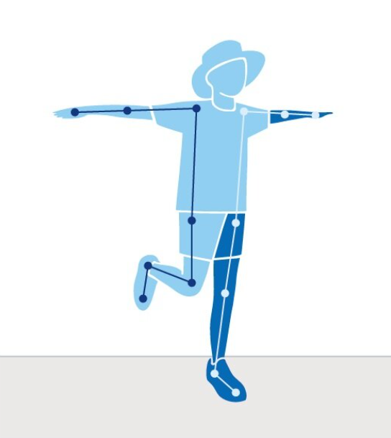
Static balance
Head stable and focus forward
Arms out and still
Torso stable and upright
Knee bent not touching the other leg
Balancing foot flat on the ground
Image long description: A person, wearing a hat, is standing on one leg with both arms stretched out to the sides. The other leg is bent backwards at the knee. Lines and dots connect to show the position of parts of the body.
Notes:
Teacher notes
Static balance components
Support leg still, foot flat on the ground
Standing still with non-support leg bent, not touching the support leg
Head stable, eyes focus forward
Torso stable and upright
No excessive arm movements
Suggested vocabulary
balance, torso, stable, non-support, upright

Slide 12
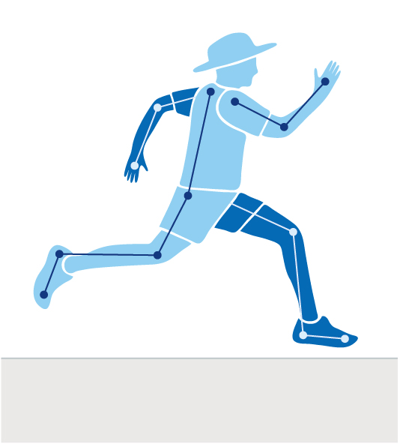
Sprint
Focus forward
Bent elbows drive forward and backwards in opposition to legs
Torso upright and stable
High knee lift
Land on the ball of the foot
Image long description: A person, wearing a hat, is in mid-stride with one leg forward and opposite arm extended. Lines and dots connect to show the position of parts of the body.
Notes:
Teacher notes
Sprint components
Lands on the ball of the foot
High knee lift with thigh almost parallel to the ground
Head and torso stable, eyes focus forward
Elbows bent at 90 degrees
Non-support knee bends at least 90 degrees during recovery phase
Elbows bent at 90 degrees
Arms drive forward and back in opposition to legs
Suggested vocabulary
upright, stable, extend, sprint, torso, ball of the foot, opposition

Slide 13
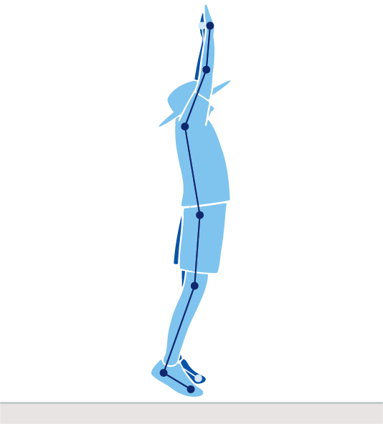
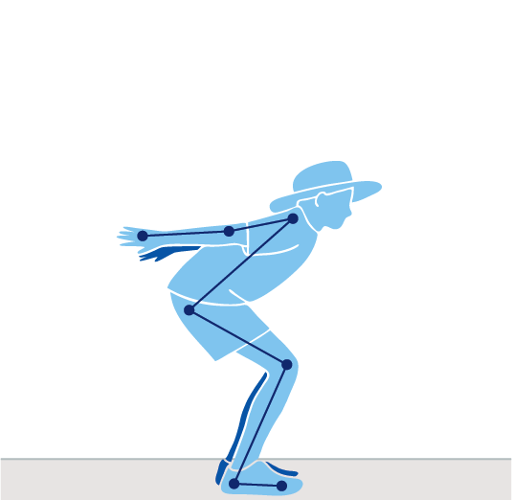
Vertical jump
Swing arms up
Head stable
Arms behind the body for propulsion
Straighten legs in the air
Crouch with knees bent for spring
Image long description: Two people, wearing hats. One is crouching with arms back, the other mid-air with arms raised. Lines and dots connect to show the position of parts of the body.
Notes:
Teacher notes
Vertical jump components
Eyes focus forward or upward throughout the jump
Crouch with knees bent and arms behind the body
Swing the arms forcefully forward and upward.
Legs straighten in the air
Land on the balls of the feet with knees bent to absorb landing
Control landing with no more than one step in any direction
Suggested vocabulary
control, jump, land, crouch, spring, straighten, stable, crouch

Slide 14
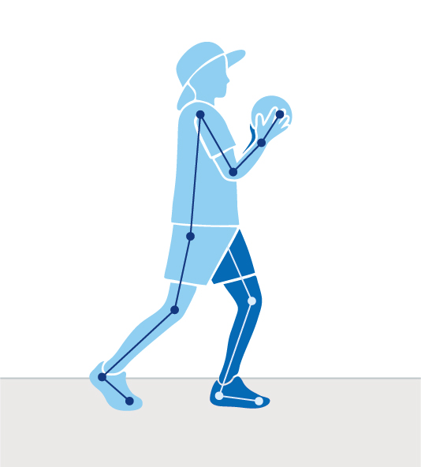
Catch
Eyes focus on object
Hand and fingers cup and catch close to body
Elbows bend to absorb the force of the object
Torso stable
Image long description: A person, wearing a hat, holding a ball close to their chest with one leg slightly behind torso in a balanced position. Lines and dots connect to show the position of parts of the body.
Notes:
Teacher notes
Catch components
Eyes focus on the object throughout the catch
Feet move to place the body in line with the object
Hands move to meet the object
Hands and fingers relaxed and slightly cupped
Catch and control the objects with hands only (well-timed closure)
Bend elbows to absorb the force of the object
Suggested vocabulary
absorb, catch, control, force

Slide 15
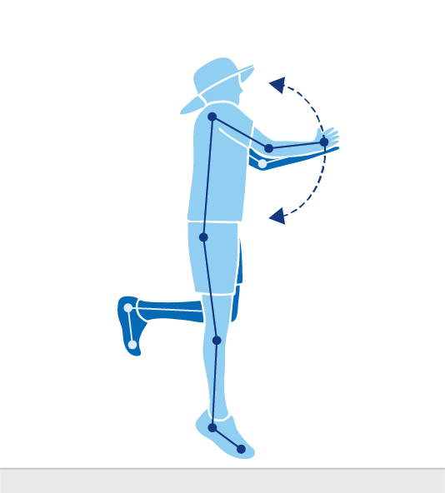
Hop
Head stable
Arms bend and swing up and forward when pushing off
Non-supporting leg bends and
swings in rhythm with the
support leg
Land on the ball of the foot
Image long description: A person, wearing a hat, with both feet off the ground. One leg is bent and one leg straight with the figure arms bent and swinging above head. Lines and dots connect to show the position of parts of the body.
Notes:
Teacher notes
Hop components
Support leg bends on landing
Land and push off on the ball of the foot
Non-support leg bent and swings in rhythm with the support leg
Head stable, eyes focus forward throughout the jump
Arms bent and swing forward as support leg pushes off
Suggested vocabulary
rhythm, hop, landing, swing, stable

Slide 16
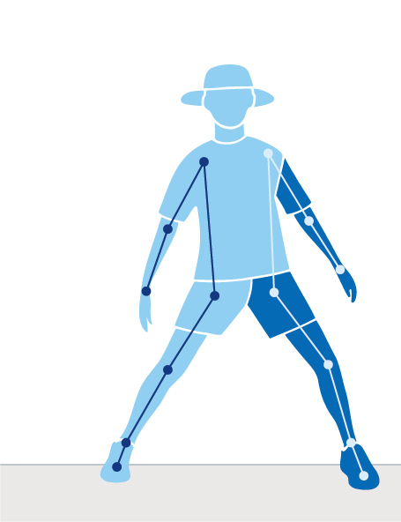
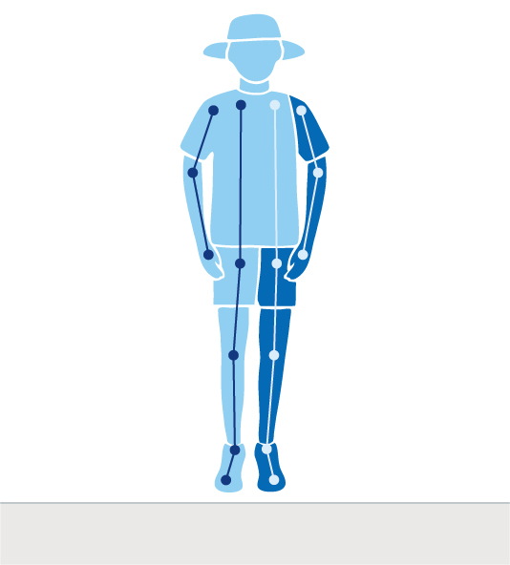
Side gallop
Head stable and eyes focus on the direction of travel
Stable torso and
hips
Legs straight in the air
Weight on the balls of the feet
Feet step-together, step-together
Image long description: Two people, wearing hats. One person has feet in a wide stance with torso upright. The other person is mid-flight in the air with both feet off the ground with legs straight and both arms down facing down next to the hip. Lines and dots connect to show the position of parts of the body.
Notes:
Teacher notes
Side gallop components
Weight on the balls of the feet
Hips and shoulders point to the front
Head stable, eyes focus forward or in the direction of travel
Smooth rhythmical movement where feet step-together, step-together
Brief flight phase where both feet are off the ground to meet in the air
Suggested vocabulary
rhythm, smooth, stable, balance, gallop, balls of the feet, torso, direction

Slide 17
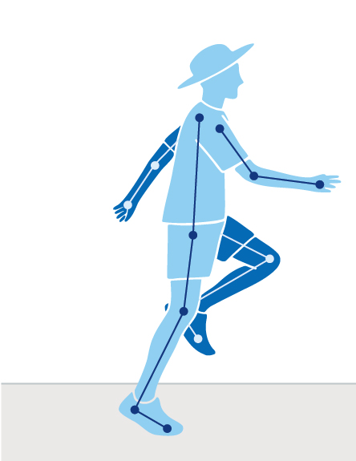
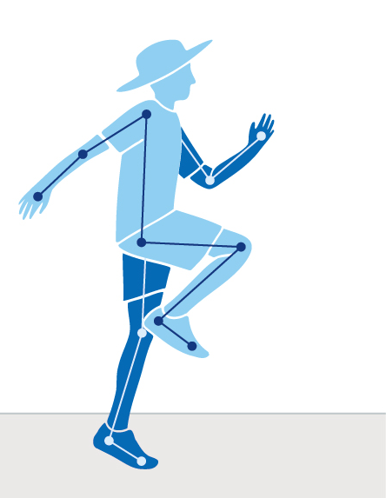

Skip
Eyes focus
forward
Arms swing opposite to legs
High knees to prepare for hop
Land on balls of feet
Image long description: Two people, wearing hats. Both with one knee forward and bent, opposite arms extended, and one foot planted on the ground. Lines and dots connect to show the position of parts of the body.
Notes:
Teacher notes
Skip components
Shows a rhythmical step-hop
Head and torso stable, eyes focus forward
Step forward and hop up landing on the ball of the foot
Arms relaxed and swing in opposition to legs
Lands on ball of the foot
Knee of support leg bends to prepare for hop
Suggested vocabulary
rhythm, skip, stable, swing, ball of the foot, torso

Slide 18
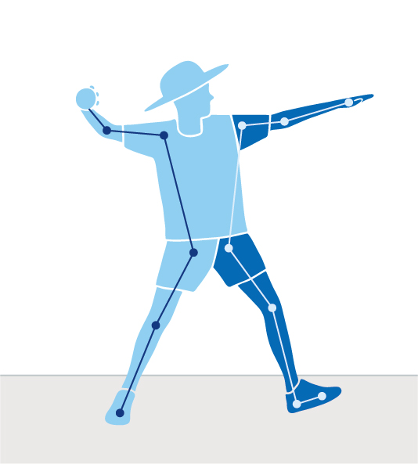
Overarm throw
Eyes focus on target
Shoulders and hip rotate towards target across the body
Torso side-on to target
Leg opposite to throwing arm Step towards target
Image long description: A person, wearing a hat. One arm is bent, holding a ball, and the other arm is pointing forward. One leg is straight, and the other knee slightly bent. Lines and dots connect to show the position of parts of the body.
Notes:
Teacher notes
Throw (Overarm) components
Eyes focus on target throughout the throw
Stand side-on to target
Throwing arm moves in a downward and backward arc
Step towards target with foot opposite throwing arm
Hips then shoulders rotate
Throwing arm follows through, down and across the body
Suggested vocabulary
target, follow through, rotate, throw, towards, focused

Slide 19
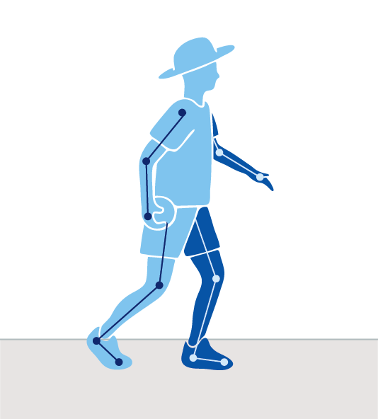
Underarm throw
Eyes focus on target
Elbow slightly bent
Swing throwing arm back and then towards target past the hip
Torso front-on to target
Step towards target
Image long description: A person, wearing a hat, holding a ball in one hand at the hip, with one leg forward and the other leg behind, slightly bent. Lines and dots connect to show the position of parts of the body.
Notes:
Teacher notes
Throw (underarm) components
Shoulders and hip facing towards target
Eyes focus on target throughout the throw
Steps towards target with foot opposite throwing arm
Throwing arm follows through past hip and away from the body
Suggested vocabulary
target, follow through, throw, towards, focused, swing, front-on

Slide 20
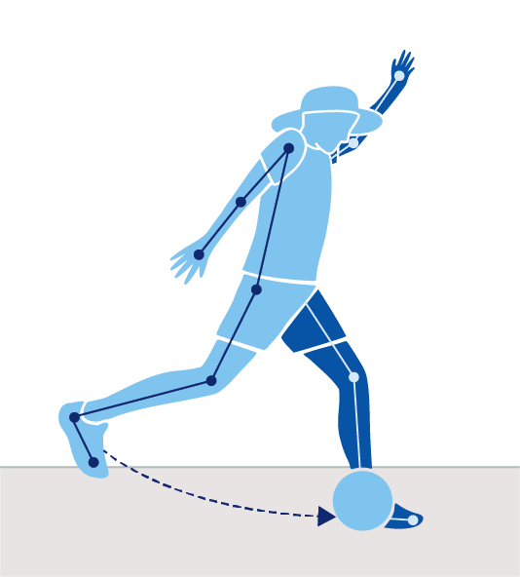
Kick
Swing arm forward through kick
Eyes focus on the ball throughout kick
Kicking leg bent
Top or inside of foot connects with the ball
Non-kicking foot
placed next to ball
Image long description: A person, wearing a hat is tilted forward with one leg bent and the other straight and planted next to a ball. One arm is swung above the head and the other arm is positioned behind the body. Lines and dots connect to show the position of parts of the body.
Notes:
Teacher notes
Kick components
Eyes focus on the ball throughout the kick
Forward and sideward swing of arm opposite to kicking leg
Non-kicking foot placed near the ball
Bend knee of kicking leg at least 90 degrees during the back-swing
Contact with ball with top of the foot (a ‘shoelace’ kick) or instep
Kicking leg follows through high towards the target
Suggested vocabulary
kick, contact, swing, follow through, instep, non-kicking, connects, throughout

Slide 21
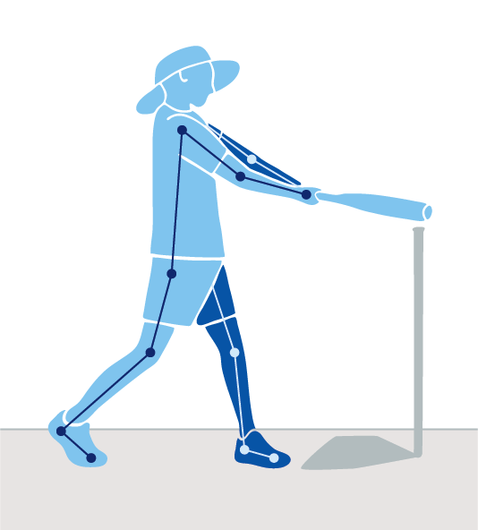
Two-handed strike (tee): Right-handed example
Eyes focus on target throughout the strike
Rotate arms and hips across body and follow through with bat
Hands next to each other, dominant hand at the base of bat
Side-on to target
Step forwards and swing
Image long description A person, wearing a hat is side-on to a softball tee. Both hands hold a tee ball bat. Lines and dots connect to show the position of parts of the body.
Notes:
Teacher notes
Two-handed strike (tee) components
Stand side-on to target
Eyes focus on the ball throughout the strike
Hands next to each other, dominant hand near the base of the bat
Step towards target with front foot
Hips then shoulders rotate forward
Contact with the ball made on front foot with straight arms
Follows through with bat around the body
Suggested vocabulary
rotate, follow through, contact, dominant, strike, swing, stable, side-on

Slide 22
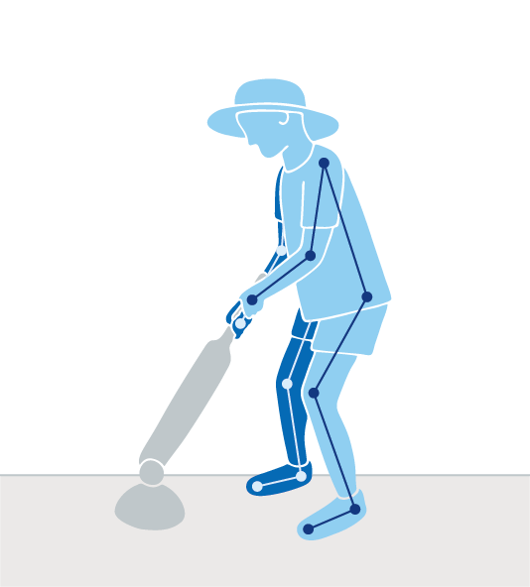
Two-handed strike (cricket): Right-handed example
Eyes focus on target throughout the strike
Rotate arms across body and follow through with bat
Side-on to target
Hands next to each other, dominant hand at the base of bat
Hips stable with minimal rotation through the strike
Image long description: A person, wearing a hat is holding a cricket bat. A small ball sits on a cone. Lines and dots connect to show the position of parts of the body.
Notes:
Teacher notes
Two-handed strike (cricket) components:
Stand side-on to target
Eyes focus on the ball throughout the strike
Hands next to each other, dominant hand near the base of the bat
Step towards target with front foot
Hips then shoulders rotate forward
Ball contact made on front foot with straight arms
Follows through with bat around the body
Suggested vocabulary
rotate, follow through, contact, dominant, strike, stable, side-on

Slide 23
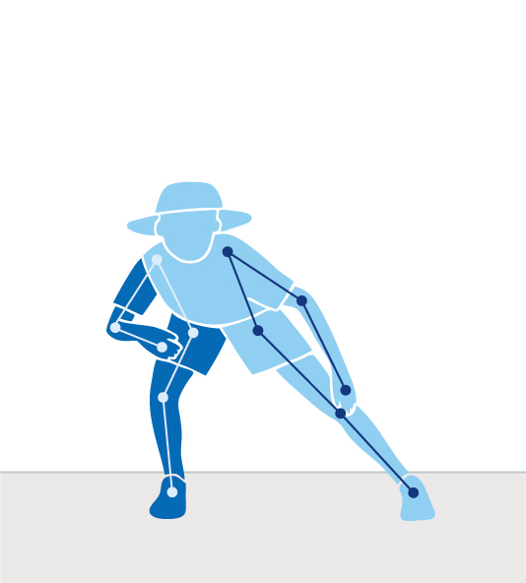
Dodge
Eyes focus forward
Lower the body during change of direction or in the direction of
travel
Bent knee
Push off the outside foot
Image long description: A person, wearing a hat, leans slightly forward and to the side over a bent knee, bearing the body weight. The opposite leg is straight. Lines and dots connect to show the position of parts of the body.
Notes:
Teacher notes
Dodge components:
Lower the body during change of direction or in the direction of travel
Eyes focus forward
Change direction by bending knee and pushing off the outside foot
Change of direction occurs in one step
Dodge repeated equally well on both sides
Suggested vocabulary
direction, stable, dodge, direction of travel

Slide 24
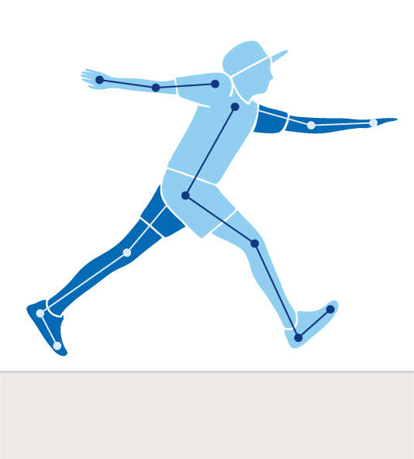
Leap
Outstretch arms
Eyes focus forward throughout the leap
Torso leans slightly forward
Legs straighten during flight
Image long description: A person, wearing a hat, has both feet off the ground with legs split. Arms outstretch forward and behind the figure. Lines and dots connect to show the position of parts of the body.
Notes:
Teacher notes
Dodge components
Eyes focus forward throughout the leap
Knee of take-off leg bends
Torso leans slightly forward
Legs straighten during flight
Arms held in opposition to the legs
Land on ball of the foot and bend knee to absorb landing
Suggested vocabulary
take-off, leap, absorb, straighten, torso, outstretch, straighten

Slide 25
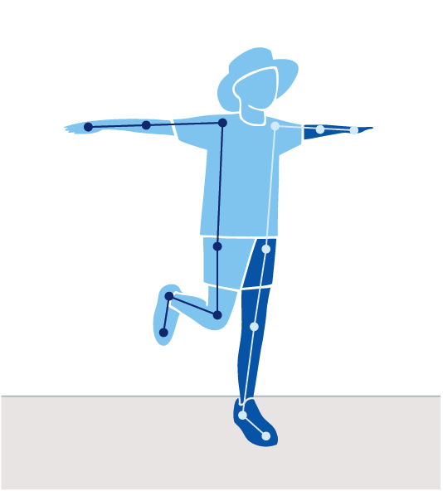
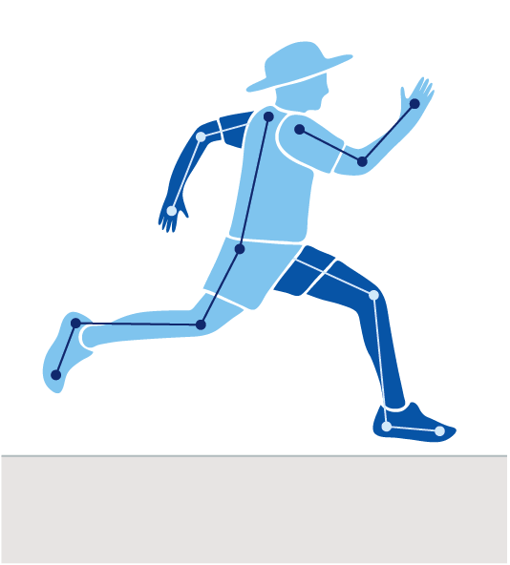
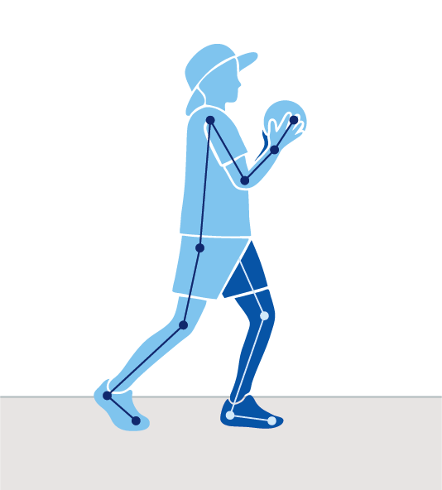
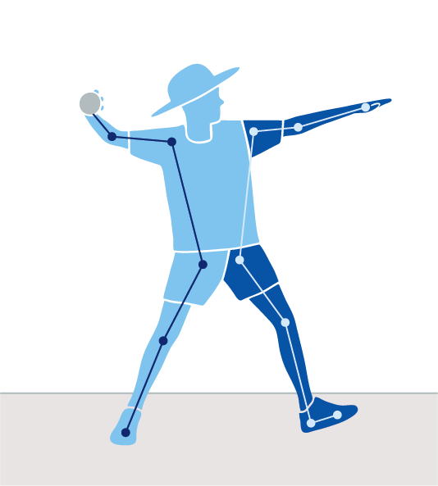
Early Stage 1
The sample physical activities and games described here align to the K–6 Sample whole-school curriculum plan.
Static balance
Run and sprint
Catch
Term 1
Term 3
Underarm throw
Overarm throw
Skip
Side gallop

Slide 26
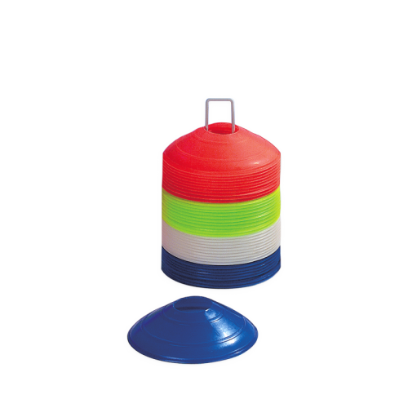
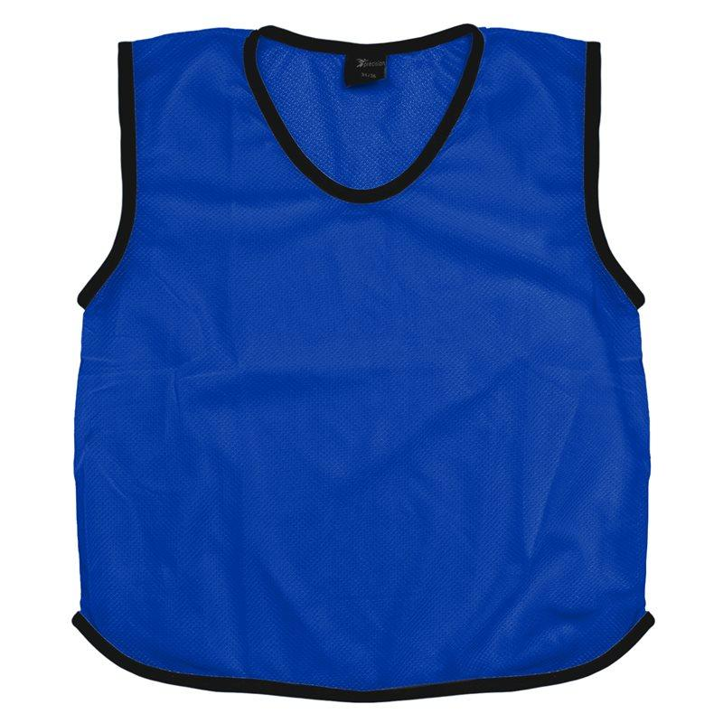
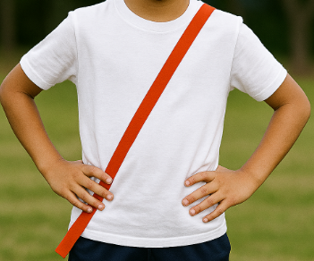
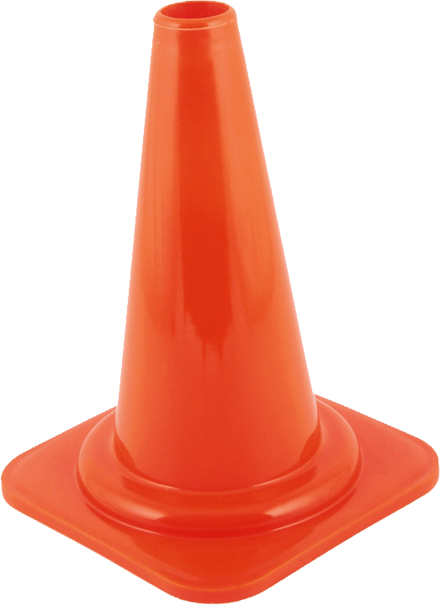
Recommended equipment list for Early Stage 1
These recommended resources are used in the sample physical activities and games.
Teachers should rregularly inspect equipment to ensure it is in good working order. The equipment quantities are approximations as schools make decisions
about resourcing based on class size and student numbers.
Markers/cones (26–30)
Sashes/bibs (26–30)
Bean bags (at least one per student)
Hoops (10–15)
Witches hats (15)
Markers/cones
Sash/bib
Witches hat

Slide 27
Early Stage 1 – Term 1
Participate with others during physical activities
Demonstrate spatial awareness during physical activities
Demonstrate fair play, safe use of equipment and rule following
Participate in physical activities which provide enjoyment and motivation to be physically active
Sample physical activity and game | Focus FMS: Fundamental movement skills are important for health and wellbeing
1. Sprint tag | Run and sprint over short distances
2. Flip it | Run and sprint over short distances
3. Scarecrow balance | Maintain stability during a static balance
4. Buddy catch | Catch objects thrown from a short distance

Slide 28
Early Stage 1 –Term 1
Syllabus content: Run and sprint over short distances
1
Game 1: Sprint tag
Students run and sprint to tag each other within a designated playing area.
Game instructions
Mark out a large playing area with cones.
Two or 3 players are the ‘taggers’ and aim to tag (touch) the ‘sprinters’.
All players can sprint. There is no 'safe zone’.
Once a sprinter is tagged, they become a tagger.
Suggested variations to the game
Change the way taggers or sprinters move e.g. taggers skip and sprinters side gallop.
On teachers call, switch the roles where sprinters become taggers and taggers become sprinters.
Once a sprinter is tagged, they join hands with the person who tagged them, and they now tag others while holding hands. Once 4 taggers are holding hands they can break into pairs.
Create a ‘safe zone’ where sprinters can seek refuge for a short period of time during the game, taggers are not allowed to enter the ‘safe zone’.
Teachers can apply adjustments to support the development of the sprint. Teachers can use the fundamental movement skills content in combination with complementary content to meet the needs of some students with physical disability.
Suggested vocabulary: drive, sprint, tagged, taggers, ball of foot, upright, stable, extend, torso
Equipment: cones, bibs or sashes
Sprint
Lands on the ball of the foot
High knee lift with thigh almost parallel to the ground
Head and torso stable, eyes focus forward
Elbows bent at 90 degrees
Non-support knee bends at least 90 degrees during recovery phase
Elbows bent at 90 degrees
Arms drive forward and back in opposition to legs

Slide 29
Early Stage 1 –Term 1
Syllabus content: Run and sprint over short distances
Game 2: Flip it
Students sprint and flip over cones in a designated playing area.
Game instructions
Scatter an even number of cones (26 plus) in a large designated playing area with half of the cones turned upside down (to represent holes) and the other half sitting the right-way up (to represent hills).
Split the class into 2 groups (holes and hills) and on the teacher signal, both teams sprint to flip the cones over to represent their team (a hole or hill).
Students attempt to flip as many cones over as they can, for their team in the designated time. Cones cannot be moved away from their position.
Suggested variations to the game
Vary the time allocation for each round, distance between cones or the number of cones.
On the teacher signal, all players stop and immediately adopt a static balance until the teacher signals again and the flipping resumes.
Teachers can apply adjustments to support the development of the sprint. Teachers can use the fundamental movement skills content in combination with complementary content to meet the needs of some students with physical disability.
Suggested vocabulary: sprint, flip, drive, tagged, taggers, ball of foot, upright, stable, extend, torso
Equipment: 26 plus cones
Sprint
Lands on the ball of the foot
High knee lift with thigh almost parallel to the ground
Head and torso stable, eyes focus forward
Elbows bent at 90 degrees
Non-support knee bends at least 90 degrees during recovery phase
Elbows bent at 90 degrees
Arms drive forward and back in opposition to legs

Slide 30
Early Stage 1 –Term 1
Syllabus content: Maintain stability during a static balance
Game 3: Scarecrow balance
Students move in a designated playing area and perform a static balance.
Game instructions
Within a designated playing area students move around like a particular Australian animal without touching each other, e.g. move like an emu, a kangaroo, a kookaburra.
When the teacher calls or signals ‘Here come the crows!’, students are directed to perform a static balance, resembling a scarecrow. Before the game continues, the teacher instructs students of the animal movement
Students' alternate legs for each scarecrow static balance.
Suggested variations to the game
Students are given a bean bag each (a crow) and on the teacher's signal, student balance the bean bag on a part of their body, e.g. shoulder, foot, head, hand.
Use music to initiate a start and stop movement.
Teachers can apply adjustments to support the development of the static balance. Teachers can use the fundamental movement skills content in combination with complementary content to meet the needs of some students with physical disability.
Suggested vocabulary: balance, torso, stable, non-support, upright
Equipment per student: 1 bean bag (optional)
Static balance
Support leg still, foot flat on the ground
Standing still with non-support leg bent, not touching the support leg
Head stable, eyes focus forward
Torso stable and upright
No excessive arm movements

Slide 31
Early Stage 1 – Term 1
Syllabus content: Catch objects thrown from a short distance
Game 4: Buddy catch
In pairs, students toss and catch a bean bag to each other.
Game instructions
In pairs, approximately one metre apart, students share one bean bag.
Students toss the bean bag back and forth to each other.
If the pair tosses and catches the bean bag 5 times without dropping it, both students take a step back. If the bean bag isn’t caught, students remain in the same position.
On the teacher’s call or signal, students change partners and the game begins again.
Suggested variations to the game
Students throw a balloon, or a different sized or weighted ball.
Adjust the number of students in groups.
Adjust the number of steps taken after 5 catches.
Teachers can apply adjustments to support the development of the catch. Teachers can use the fundamental movement skills content in combination with complementary content to meet the needs of some students with physical disability.
Suggested vocabulary: toss, catch, absorb, control, force, cupped
Equipment per pair: one bean bag
Catch
Eyes focus on the object throughout the catch
Feet move to place the body in line with the object
Hands move to meet the object
Hands and fingers relaxed and slightly cupped
Catch and control the object with hands only (well-timed closure)
Bend elbows to absorb the force of the object

Slide 32
Early Stage 1 – Term 3
Participate with others during physical activities
• Demonstrate fair play, safe use of equipment and rule following
• Identify the diverse ways in which people participate in physical activities
• Participate in physical activities which provide enjoyment and motivation to be physically active
Sample physical activity and game | Focus FMS: Fundamental movement skills are important for health and wellbeing
1. River, bank, bush | Side gallop with rhythm
2. Side gallop path | Side gallop with rhythm
3. Skip to the colour | Skip with a rhythmical pattern
4. Bullseye! | Throw underarm and overarm towards a target from a stationary position

Slide 33
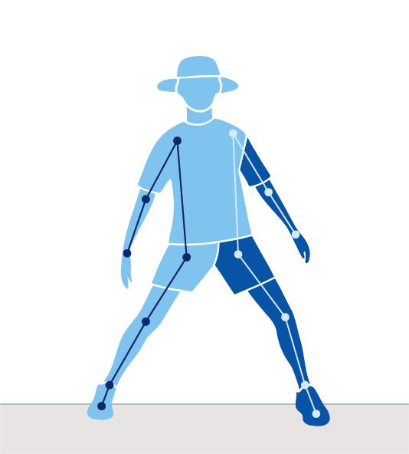
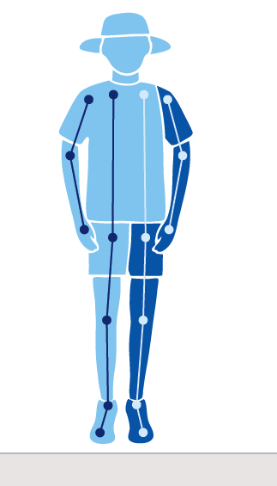
Early Stage 1 –Term 3
Syllabus content: Side gallop with rhythm
Game 1: River, bank, bush
Students practice side galloping, changing their leading leg.
Game instructions
Set up a large playing square with the right side of the square being the ‘bush’, the left side being the ‘river’, and the middle ‘the bank’.
Students move into the middle area ‘the bank’ facing the teacher.
The teacher calls out either ‘bank’, ‘river’ or ‘bush’ and students side gallop either left or right to get to the destination as fast as possible.
Suggested variations to the game
Vary the time between calling different directions.
Vary the size of the playing space, the distance between the ‘river’, ‘bank’, ‘bush’.
Once a destination is reached, an action is performed, for example 3 vertical jumps.
Teachers can apply adjustments to support the development of the side gallop. Teachers can use the fundamental movement skills content in combination with complementary content to meet the needs of some students with physical disability.
Suggested vocabulary: rhythmic, stable, balance, gallop, torso, left, right, bank, smooth, stable, direction
Equipment: cones
Side gallop
Weight on the balls of the feet
Hips and shoulders point to the front
Head stable, eyes focus forward or in the direction of travel
Smooth rhythmical movement where feet step-together, step-together
Brief flight phase where both feet are off the ground to meet in the air

Slide 34
Early Stage 1 –Term 3
Syllabus content: Side gallop with rhythm
Game 2: Side gallop path
Students side gallop through a natural and built ‘course’.
Game instructions
Using the natural and built playground that is available, the teacher directs students to move through a ‘course’ by side galloping.
This could include side galloping around the tree, between the lunch seats and to the steps of the classroom to return to the starting point.
Suggested variations to the game
Incorporate other ways of moving through the course, e.g. after side galloping through the course sprint back to the starting cone, hopping along a painted line on the asphalt, or toss a bean bag in the air and clap 3 times.
Teachers can apply adjustments to support the development of the side gallop. Teachers can use the fundamental movement skills content in combination with complementary content to meet the needs of some students with physical disability.
Suggested vocabulary: rhythmic, smooth, stable, balance, gallop, direction
Equipment: natural landmarks, playground environment
Side gallop
Weight on the balls of the feet
Hips and shoulders point to the front
Head stable, eyes focus forward or in the direction of travel
Smooth rhythmical movement where feet step-together, step-together
Brief flight phase where both feet are off the ground to meet in the air

Slide 35
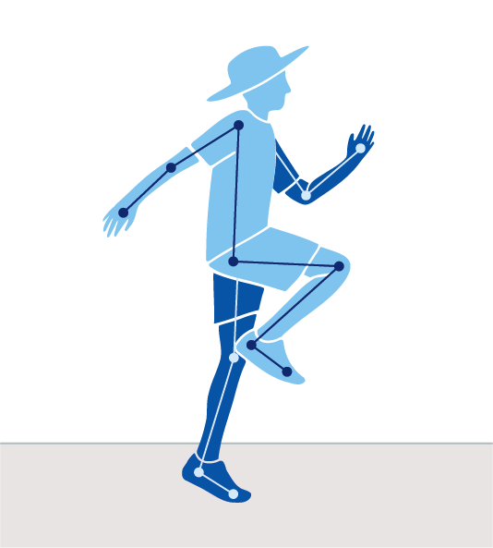
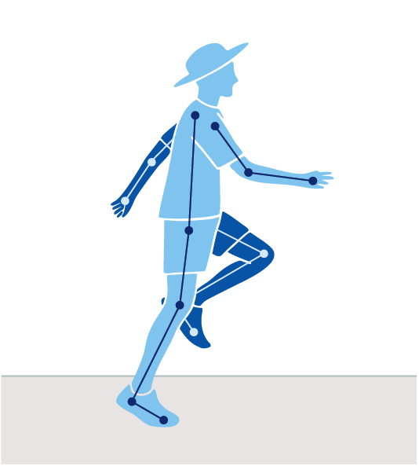
Early Stage 1 –Term 3
Syllabus content: Skip with a rhythmical pattern
Game 3: Skip to the colour
Students skip within a designated playing area and on the teachers call, skip to a nominated coloured marker.
Game instructions
Place multiple, coloured markers, widely and randomly in a designated playing area.
Students skip around the designated space.
On teacher signal and call, a colour is called out. Students skip quickly to that colour and hold hands around that coloured marker.
Suggested variations to the game
Call out a sequence of colours to skip to e.g. red, blue, red.
Add a task if students bump into each other, e.g. 10 second static balance.
When students reach the target-coloured marker, they perform an action, e.g. star-jumps.
Teachers can apply adjustments to support the development of the skip. Teachers can use the fundamental movement skills content in combination with complementary content to meet the needs of some students with physical disability.
Suggested vocabulary: rhythmic, stable, skip, balanced, torso
Equipment: multiple-coloured markers
Skip
Shows a rhythmical step-hop
Head and torso stable, eyes focus forward
Step forward and hop up landing on the ball of the foot
Arms relaxed and swing in opposition to legs
Lands on ball of the foot
Knee of support leg bends to prepare for hop

Slide 36
Early Stage 1 –Term 3
Syllabus content: Throw underarm and overarm towards a target from a stationary position
Game 4: Bullseye!
Students throw a bean bag or object underarm or overarm, to land and/or roll as close as possible to a marker.
Game instructions
Divide students into small teams. Each team places a target, eg a cone, witches hat or hoop, approximately 5 to 10 metres away from a starting spot. Each student has 2 or more bean bags.
One player at a time from each team, throws their bean bag underarm or overarm at the target, aiming to get as close as possible.
Play continues until all players have thrown their beanbags.
Suggested variations to the game
Vary the size and distance of the target.
Include a time allocation for each round.
Teachers can apply adjustments to support the development of the underarm and overarm throw. Teachers can use the fundamental movement skills content in combination with complementary content to meet the needs of some students with physical disability.
Suggested vocabulary: aim, target, control, rotate, towards
Equipment per group: one to 2 or more bean bags per student, one cone or hoop
Underarm
Shoulders and hip facing towards target
Eyes focus on target throughout the throw
Steps towards target with foot opposite throwing arm
Throwing arm follows through past hip and away from the body
Overarm
Eyes focus on target throughout the throw
Stand side-on to target
Throwing arm moves in a downward and backward arc
Step towards target with foot opposite throwing arm
Hips then shoulders rotate
Throwing arm follows through, down and across the body

Slide 37
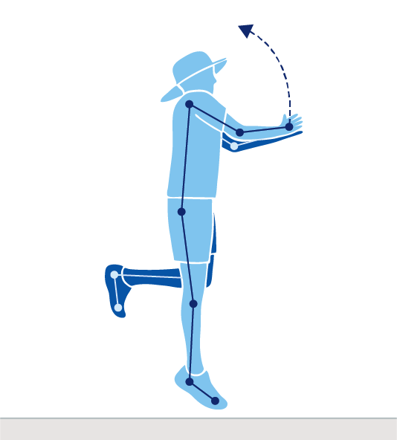
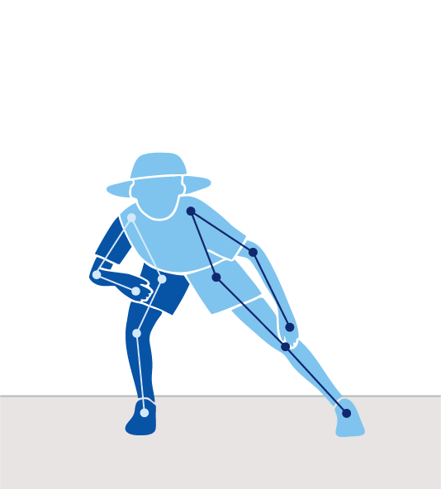
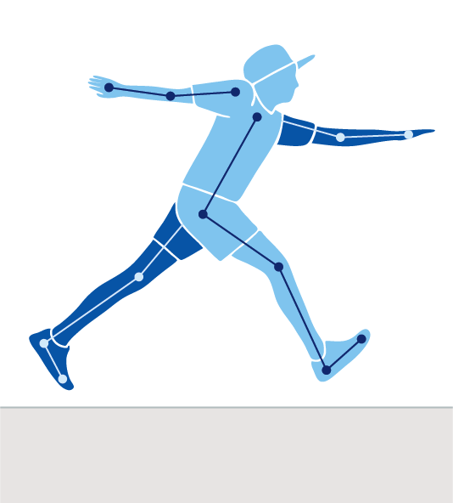

Stage 1
The sample physical activities and games described here align to the K–6 Sample whole-school curriculum plan.
Term 2
Term 8
Hop
Skip
Jump
Leap
Strike
Dodge

Slide 38
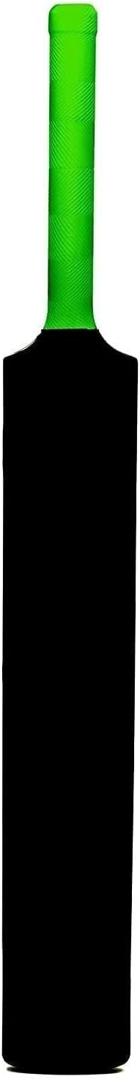
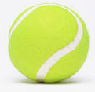
Recommended equipment list for Stage 1
These recommended resources are used in the sample physical activities and games.
Teachers should regularly inspect equipment to ensure it is in good working order. The equipment quantities are approximations as schools make decisions
about resourcing based on class size and student numbers
Hoops (10–15)
Bean bags (15–20)
Witches hat (10–12)
Small, bouncy balls (20–30)
Cricket bats (plastic) (10–12)
Markers/cones (26–30)
Witches hat
Markers/cones
Cricket bat (plastic)
Small, bouncy ball

Slide 39
Stage 1 – Term 2
Participate with others safely and fairly in physical activities
Identify and participate in physical activities to enhance enjoyment and motivation to be physically active
Describe ways in which people use their strengths and abilities to be physically active
Participate in and describe the purpose of Aboriginal and/or Torres Strait Islander games and activities
Sample physical activity and game | Focus FMS: Fundamental movement skills support health and wellbeing
1. Jump frog, jump! | Jump vertically and horizontally with control
2. Mix and match | Hop from one point to another around objects
3. Fishing | Skip at different speeds and directions in games
4. Edor | Skip at different speeds and directions in games

Slide 40
Stage 1 – Term 2
Syllabus content: Jump vertically and horizontally with control
Game 1: Jump frog, jump!
Students jump with 2 feet together through the hoops to reach the ‘riverbank’.
Game instructions
In a designated playing area, scatter approximately 10 to 15 hoops as lily-pads, and cones to indicate the beginning and end of the course.
On the teachers call or signal, students’ take turns to jump into hoops (lily-pad), to reach the end of the course.
Suggested variations to the game
Adjust the position, distance between and number of hoops.
Include a time allocation for each round.
Teachers can apply adjustments to support the development of the vertical jump. Teachers can use the fundamental movement skills content in combination with complementary content to meet the needs of some students with physical disability.
Suggested vocabulary: control, land, crouch, swing, absorb, spring, straighten, stable
Equipment per group: cones, approximately 10 to 15 hoops
Vertical jump
              Eyes focus forward or upward throughout the jump
              Crouch with knees bent and arms behind the body
              Swing the arms forcefully forward and upward.
              Legs straighten in the air
              Land on the balls of the feet with knees bent to absorb landing
              Control landing with no more than one step in any direction

Slide 41
Stage 1 – Term 2
Syllabus content: Hop from one point to another around objects
Game 2: Mix and match
Students mix and match bean bags in hoops while hopping in a designated playing space.
Game instructions
Scatter approximately 10 hoops and an even number of bean bags, approximately 14 to 16 in a large designated space.
Divide the class in half, with one half of the class to pair the bean bags in the hoops. The other half of the class do the opposite by taking the bean bags out of the hoops and scattering them within the designated space. Only 2 beans bags are allowed per hoop and only one bean bag can be carried by a student at a time.
Students can only hop and on the teacher's signal, students hop to either pair the bean bags in the hoops or scatter them out of the hoops, until the signal is to stop. If only one bean bag in a hoop, this hoop isn’t counted.
At the end of the round the class counts how many hoops have paired bean bags in them. Teams then swap to pair or scattering bean bags.
Suggested variations to the game
Vary the period of time for each round, the distance between or the number of hoops.
Select different FMS for each rally round e.g. leap or skip.
Teachers can apply adjustments to support the development of the hop. Teachers can use the fundamental movement skills content in combination with complementary content to meet the needs of some students with physical disability.
Suggested vocabulary: lead, stable, rhythm
Equipment: hoops, bean bags, cones/markers
Hop
Support leg bends on landing
Land and push off on the ball of the foot
Non-support leg bent and swings in rhythm with the support leg
Head stable, eyes focus forward throughout the jump
Arms bent and swing forward as support leg pushes off

Slide 42
Stage 1 – Term 2
Syllabus content: Skip at different speeds and directions in games
Game 3: Fishing
Students skip to evade being tagged in a designated playing area.
Game instructions
Mark a large playing area, approximately 20 metres by 20 metres and scatter 8 plus hoops. Select 3 to 4 students to be ‘sharks’, 2 to 3 students ‘dolphins’, and all other students are ‘fish’. All players move around the playing area by skipping.
Once a fish or a dolphin is tagged (caught) by the sharks, they move to the nearest hoop (net).
Only dolphins can free a fish by tagging them.
If a dolphin is tagged by a shark, they must also move into a hoop. Dolphins can be freed by another dolphin tagging them.
Change roles after a period of time.
Suggested variations to the game
  Vary the number of dolphins.
  Vary the size of the playing area.
  Change the way either the fish, dolphins or sharks move.
Teachers can apply adjustments to support the development of the skip. Teachers can use the fundamental movement skills content in combination with complementary content to meet the needs of some students with physical disability.
Suggested vocabulary: rhythm, stable, torso
Equipment: approximately 8 hoops
Skip
Shows a rhythmical step-hop
Head and torso stable, eyes focus forward
Step forward and hop up landing on the ball of the foot
Arms relaxed and swing in opposition to legs
Lands on ball of the foot
Knee of support leg bends to prepare for hop

Slide 43
Stage 1 – Term 2
Syllabus content: Skip at different speeds and directions in games
Game 4: Edor
Edor is a chasing and tagging game that originates in the Aurukun Aboriginal Community. One student; ‘Edor’ skips to reach their goal line without being tagged.
Game instructions
Mark out 5 to 6 playing spaces, each with 2 opposing goal lines. Allocate 2 groups of 4 to 6 in each playing space e.g., 4 verses 4 or 6 verses 6.
One student in each playing space is selected as the Edor and students from both teams spread out in their playing space. All students must only skip in their designated playing space.
On the teachers call, the Edor attempts to skip to their goal line without being tagged. If the Edor is tagged by their opposing team, that student who made the tag then becomes the Edor and the game continues.
The Edor’s team is not allowed to interfere with the tagging team.
The game continues until an Edor reaches their goal line. When a Edor reaches the goal their team wins the round and then all players meet in the centre of the field to start a new game.
Suggested variations to the game
Vary the number of Edors, players per group or playing space dimensions.
Teachers can apply adjustments to support the development of the skip. Teachers can use the fundamental movement skills content in combination with complementary content to meet the needs of some students with physical disability.
  Suggested vocabulary: rhythm, stable, torso, Edor, Aurukun
Equipment per group: cones
Skip
Shows a rhythmical step-hop
Head and torso stable, eyes focus forward
Step forward and hop up landing on the ball of the foot
Arms relaxed and swing in opposition to legs
Lands on ball of the foot
Knee of support leg bends to prepare for hop
The icon represents the Cultural wellbeing, identity, belonging, kinship, connection and Community. The child is at the centre of Cultural wellbeing and supported by their mob. The beige wavy line represents kinship which is an interconnecting bond that is strong. The outer ochre circle represents the diverse Communities a child may belong to. Artwork by Paige Coe

Slide 44
Stage 1 – Term 8
Participate with others safely and fairly in physical activities
Identify and participate in physical activities to enhance enjoyment and motivation to be physically active
Describe ways in which people use their strengths and abilities to be physically active
Participate in and describe the purpose of Aboriginal and/or Torres Strait Islander games and activities
Sample physical activity and game | Focus FMS: Fundamental movement skills support health and wellbeing
Puddle leap | Leap, using a long running step
2. Crab tag | Dodge, pushing from the outside foot
3. Ant tag | Dodge, pushing from the outside foot
4. 3-ball strike | Strike an object using an implement towards a target

Slide 45
Stage 1 – Term 8
Syllabus content: Leap, using a long running step
Game 1: Puddle leap
Students leap over hoops (puddles) to reach the opposite side of a designated playing area.
Game instructions
Across a large area scatter 20 plus hoops (puddles) (see Figure 1).
Students standing along a border of the space are allocated one colour (ie a line of blue, a line of red etc).
The teacher calls or signals a colour, and the students standing on that colour line, leap over the puddles to reach the other side of the playing area.
Once all students have reached the other side, the game starts again.
Suggested variations to the game
Vary the size of the playing area and the number of hoops.
Change the group categories, e.g. animals or letters.
Students count the number of puddles they leap over as they cross the playing area.
Teachers can apply adjustments to support the development of the leap. Teachers can use the fundamental movement skills content in combination with complementary content to meet the needs of some students with physical disability.
Suggested vocabulary: absorb, torso, outstretch
Equipment: cones, 20 plus hoops
Leap
Eyes focus forward throughout the leap
Knee of take-off leg bends
Torso leans slightly forward
Legs straighten during flight
Arms held in opposition to the legs
Lands on ball of the foot and bends knee to absorb landing

Slide 46
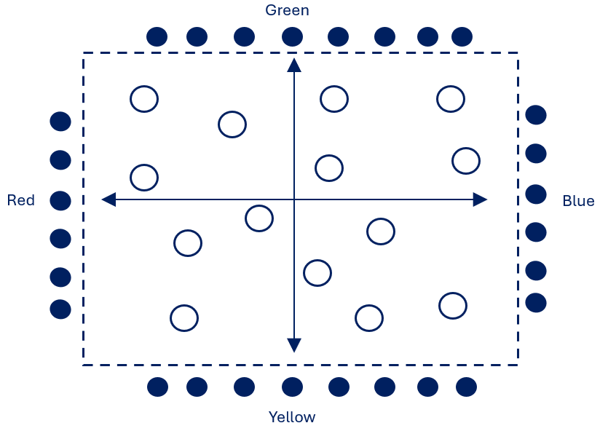
Stage 1 – Term 8
Syllabus content: Leap, using a long running step
Figure 1: Puddle leap
Students leap over hoops (puddles) to reach the opposite side of a designated playing area.
Key
Student direction
Student
Boundary markers - - - - - -
Hoops
Figure 1: Physical activity or game set up and student positioning
Notes:
Image long description (Key): Under the heading ‘key’, four items are listed:
The first label reads ‘Student direction’; next to it is an arrow pointing to the right.
The second label reads ‘Student’; next to it is a circle shaded blue.
The third label reads ‘Boundary markers’; next to it is a dashed line.
The fourth label reads ‘Hoops’; next to it is the outline of a circle.
Image long description (Figure 1): On a white rectangular background appears a rectangle drawn with dashed lines, representing boundary markers. Around the outside of the boundary markers are circles shaded blue, representing students. The students on the left side of the rectangle are labelled ‘Red’; the students along the top side of the rectangle are labelled ‘Green’; the students along the right side of the rectangle are labelled ‘Blue’; the students along the bottom of the rectangle are labelled ‘Yellow’. On the inside of the boundary, a line with arrows at each end is drawn horizontally, which intersects with a second line drawn vertically, with arrows at each end. The arrows represent the direction in which students are to move. The intersection of the lines creates 4 sections. Within each section are placed a series of circle outlines, representing hoops.

Slide 47
Stage 1 – Term 8
Syllabus content: Dodge, pushing from the outside foot
Game 2: Crab tag
Students run from one side of the playing area to the other, dodging to evade being tagged by the crabs.
Game instructions
Mark put a large playing area, approximately 15 metres by 6 metres. Place 5 cones in a line on the left side, approximately 2 metres apart. Repeat on the right side, dividing the playing area into 4 channels.
Assign 3 students to be the first crabs in each of the channels. All other students stand along one side of the playing area (see Figure 2).
On the teachers call or signal, students run and dodge to get to the other side without being tagged by the crabs.
Crabs can only side gallop within their designated channel to tag the other students. If a student is tagged by a crab that student also becomes a crab in that channel to tag other players.
Suggested variations to the game
Place students in small groups (e.g. colours, animals, numbers) and on teacher call or signal one group at a time runs and dodges to reach the other side.
Vary the number of crabs to start the game.
Teachers can apply adjustments to support the development of the dodge. Teachers can use the fundamental movement skills content in combination with complementary content to meet the needs of some students with physical disability.
Suggested vocabulary: dodge, evade
Equipment: markers or cones
Dodge
Body lowered during change of direction or in the direction of travel
Eyes focus forward
Changes direction by bending knee and pushing off the outside foot
Change of direction occurs in one step
Dodge repeated equally well on both sides

Slide 48
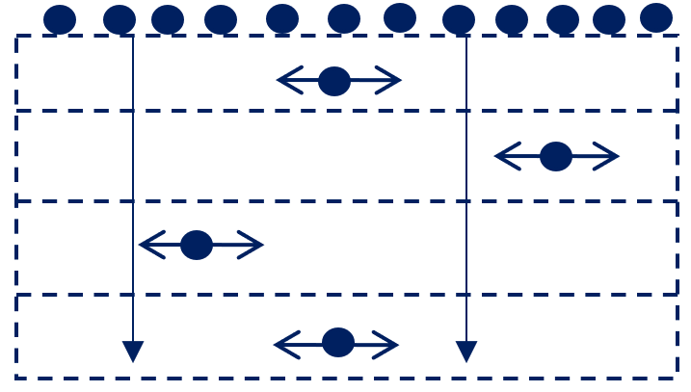
Stage 1 – Term 8
Syllabus content: Dodge, pushing from the outside foot
Figure 2: Crab tag
Students run from one side of the playing area to the other, dodging to evade being tagged by the crabs.
Key
Crabs and direction
Student
Boundary markers - - - - - -
Figure 2: Physical activity or game set up and student positioning
Notes:
Image long description (Key): Under the heading ‘Key’, 3 items are listed:
The first label reads ‘Crabs and direction’; next to it is a blue shaded circle with a green stripe running through it diagonally. A line with arrows at both ends runs horizontally through the centre of the circle.
The second label reads ‘Student’; next to it is a circle shaded blue.
The third label reads ‘Boundary markers’; next to it is a dashed line.
Image long description (Figure 2): Five dashed lines representing boundary markers run horizontally across a rectangle, creating 4 evenly spaced rows. Twelve shaded circles representing students are positioned along the boundary at the top of the image. In the centre of the first row is a blue shaded circle with a green stripe running through it diagonally, representing the crab. A line with arrows at both ends runs horizontally through the centre of the circle, indicating the directions in which the crab can move. Another crab is positioned at the right end of the second row; a third crab is positioned towards the left-hand end of the third row; a fourth crab is positioned in the centre of the fourth row. Two lines run from the top boundary marker to the bottom boundary, each ending with a downward-pointing arrow.

Slide 49
Stage 1 – Term 8
Syllabus content: Dodge, pushing from the outside foot
Game 3: Ant Tag
Students dodge and evade being tagged by other students to make it to the other side of the playing space.
Game instructions
Set up a rectangular playing space approximately 15 metres by 10 metres.
One student is the ‘Queen ant’ who starts in the middle of the area. The ‘Queen ant’ can run freely in the playing space.
The other students line up on one side of the playing area. They are the ‘ants’.
The Queen calls out ‘Run, little ants!’ which signals the beginning of the game. The ants run and dodge the Queen, making their way to the other side of the playing area.
Tagged students hold hands with the Queen until there are 4 students holding hands. Then the chain can break in half and each pair of ants tries to tag other ants.
Options for adjusting the game
Vary the size of the playing area and the number of Queen ants to begin with.
Different locomotor actions can be used by the Queen ants and the ants e.g. skip, powerwalk, side gallop, hop.
Teachers can apply adjustments to support the development of the dodge. Teachers can use the fundamental movement skills content in combination with complementary content to meet the needs of some students with physical disability.
Suggested vocabulary: dodge, direction, stable
Equipment per group: cones
Dodge
Body lowered during change of direction or in the direction of travel
Eyes focus forward
Changes direction by bending knee and pushing off the outside foot
Change of direction occurs in one step
Dodge repeated equally well on both sides

Slide 50
Stage 1 – Term 8
Syllabus content: Strike an object using an implement towards a target
Game 4: 3-ball strike
Students strike balls towards a target.
Game instructions
In groups of approximately 3, students place 3 tennis balls on 3 cones, approximately 1 metre apart with a target (eg witches hat) placed approximately 2-3 metres away
One student in the group is the striker and the other 2 are fielders standing in front of the striker, a safe distance away
The striker hits one ball at a time off the cones at the target. Once all 3 balls have been struck from the cones the fielders run to return the balls back to the cones and another student becomes the striker.
Suggested variations to the game
Vary the number and size of targets
Set up more than 3 balls/cones
Teachers can apply adjustments to support the development of the strike. Teachers can use the fundamental movement skills content in combination with complementary content to meet the needs of some students with physical disability.
Suggested vocabulary: retrieve, rotate, contact, dominant, stable
Equipment per group: 3 tennis balls, 3 cones, cricket bat, target or witches hat.
Two handed strike (Right handed):
Stand side-on to target
Eyes focused on the ball throughout the strike
Hands next to each other, dominant hand near the base of the bat matches the front foot
Steps towards target with front foot
Hips then shoulders rotate forward
Ball contact made on front foot with straight arms
Follows through with bat around the body.

Slide 51
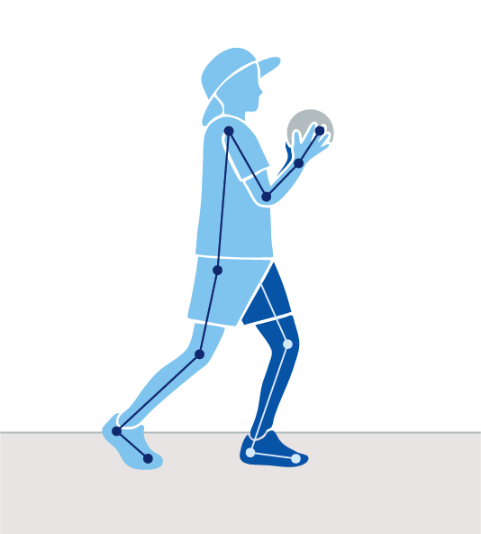
Stage 2
The sample physical activities and games described here align to the K–6 Sample whole-school curriculum plan.
Term 1
Term 7.
Underarm throw
Catch
Overarm throw
Strike
Static balance

Slide 52
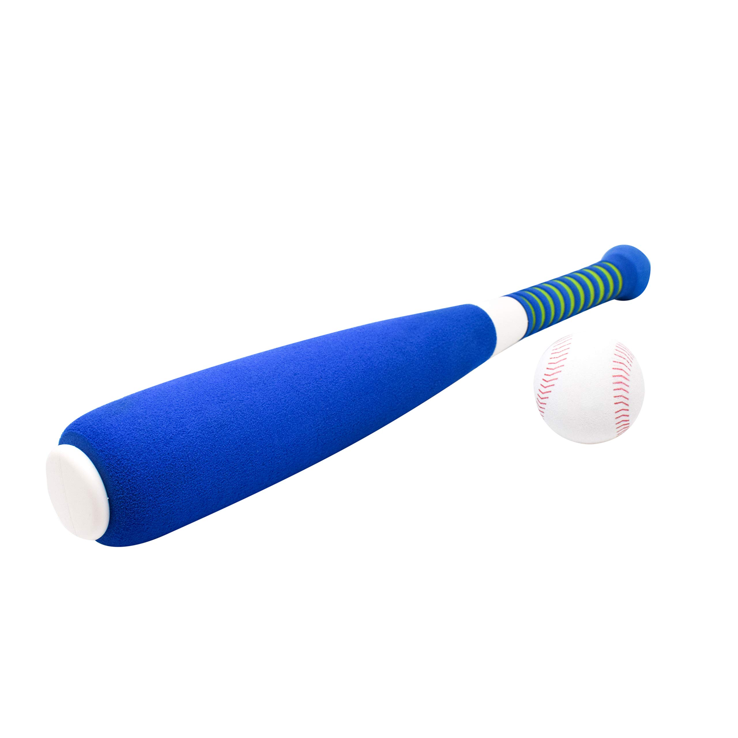

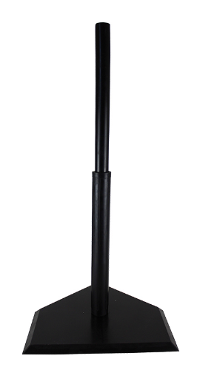
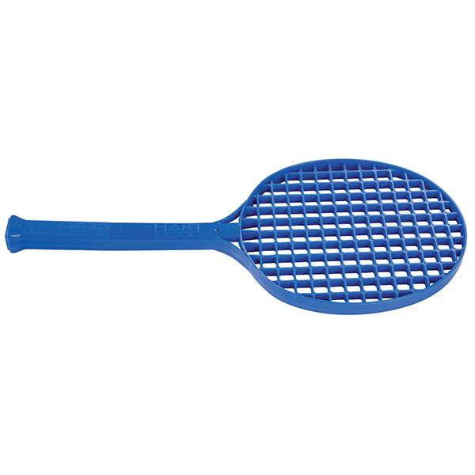
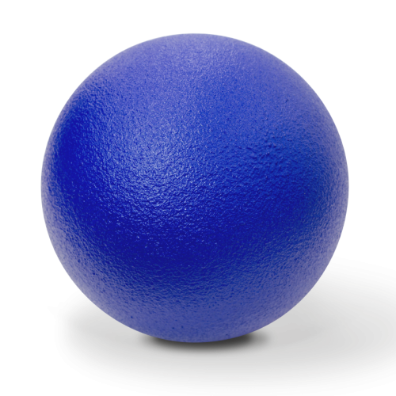
Recommended equipment list for Stage 2
These recommended resources are used in the sample physical activities and games.
Teachers should regularly inspect equipment to ensure it is in good working order. The equipment quantities are approximations as schools make decisions
about resourcing based on class size and student numbers.
Witches hat (20–30)
Hoops (10–15)
Markers/cones (26–30)
Bean bags (2 per student)
Large soft balls (6–8)
Small, bouncy balls (10–12)
Foam Tee-Ball bats (2)
Tee-Ball stands (2)
Cricket bat or tennis racquets (5–6)
Markers/cones
Tee-ball bat (foam)
Tee-ball stand
Small, bouncy ball
Medium sized, soft ball
Racquet (plastic)

Slide 53
Stage 2 – Term 1
Cooperate and communicate for teamwork in physical activities
• Demonstrate skills and strategies in target, net and court, striking and fielding, territory games and modified sport
• Pass and receive a ball at different levels and directions in games and modified sport
• Promote ways to be inclusive in physical activities to cater for the diverse ways people move.
Sample physical activity and game | Focus FMS: Consolidating fundamental movement skills improves health and wellbeing
1. Knock them down | Throw underarm or overarm towards a target at different levels with control
2. Protect the target | Throw underarm or overarm towards a target at different levels with control
3. Two-square bounce | Move and adjust the body to catch balls and objects of various shapes and sizes
4. Mini Newcombe ball | Move and adjust the body to catch balls and objects of various shapes and sizes Throw underarm or overarm towards a target at different levels with control

Slide 54
Stage 2 – Term 1
Syllabus content: Throw underarm or overarm towards a target at different levels with control
Game 1: Knock them down
Underarm
Shoulders and hip facing towards target
Eyes focus on target throughout the throw
Steps towards target with foot opposite throwing arm
Throwing arm follows through past hip and away from the body
Overarm
Eyes focus on target throughout the throw
Stand side-on to target
Throwing arm moves in a downward and backward arc
Step towards target with foot opposite throwing arm
Hips then shoulders rotate
Throwing arm follows through, down and across the body
Students throw overarm and underarm to quickly knock down targets.
Game instructions
  Divide students into groups of approximately 4. Each group of students has a row of 2 to 5 targets (e.g. witches hats), placed at approximately one metre intervals (see Figure 3).
  Allocate approximately 8 to 12 bean bags per group.
  Students take turns to throw a bean bag at the first target. Once this has been hit with the bean bag, the group progresses to the next target in the row, until all have been knocked down.
Suggested variations to the game
  Vary distances, type of throwing object, number of targets, type of target.
  Number of students in each team.
  Include a time allocation for each round.
Teachers can apply adjustments to support the development of the underarm and overarm throw. Teachers can use the fundamental movement skills content in combination with complementary content to meet the needs of some students with physical disability.
Suggested vocabulary: control, rotate
Equipment per group: bean bags (8 to 12), 2 to 5 targets (e.g. witches hats)

Slide 55
Stage 2 – Term 1
Syllabus content: Throw underarm or overarm towards a target at different levels with control
Figure 3: Knock them down
Students throw overarm and underarm to quickly knock down targets of increasing distance.
Key
Object and direction
Student
Boundary markers - - - - - -
Targets
-----------------------------------------------------------------
Figure 3: Physical activity or game set up and student positioning
Notes:
Image long description (Key): Under the heading ‘Key’, 4 items are listed:
The first label reads ‘Object and direction’; next to it is a circle shaded red with an arrow extending outwards to the right.
The second label reads ‘Student’; next to it is a circle shaded blue.
The third label reads ‘Boundary markers’; next to it is a dashed line.
The fourth label reads ‘Targets’; next to it is a triangle shaded green.
Image long description (Figure 3): On a white square-shaped background is shown a grid of twenty green-shaded triangles pointing upward, arranged in 4 rows of 5. Below this grid, there is a dashed line which runs horizontally across the width of the image. Under the dashed line, there is a row of evenly-spaced circles, shaded red, with a single red arrow pointing straight upward. Below each red circle are five circles shaded blue.

Slide 56
Stage 2 – Term 1
Syllabus content: Throw underarm or overarm towards a target at different levels with control
Game 2: Protect the target
Underarm
Shoulders and hip facing towards target
Eyes focus on target throughout the throw
Steps towards target with foot opposite throwing arm
Throwing arm follows through past hip and away from the body
Overarm
Eyes focus on target throughout the throw
Stand side-on to target
Throwing arm moves in a downward and backward arc
Step towards target with foot opposite throwing arm
Hips then shoulders rotate
Throwing arm follows through, down and across the body
Students pass and receive a ball before throwing it past a defending player to hit the target.
Game instructions
Divide students into groups of approximately 5, with 4 of the players forming a 2 metre plus perimeter around one player (Player A), who protects the target.
The ball must be passed quickly between the 4 players at least 3 times, before the ball can be thrown at the target. Player A protects the target by catching or batting away the ball.
Once the target has been hit, rotate Player A role through the group.
Suggested variations to the game
  The number of players
  The size of the target.
  The distance between the target and the players.
  Include timed conditions before swapping roles.
  Use different sized, weighted or textured balls.
  Teachers can apply adjustments to support the development of the underarm and overarm throw. Teachers can use the fundamental movement skills content in combination with complementary content to meet the needs of some students with physical disability.
Suggested vocabulary: pass, protect, possession, defend, towards, control, rotate
Equipment per group: one medium-sized soft ball, one target, cones

Slide 57
Stage 2 – Term 1
Syllabus content: Throw underarm or overarm towards a target at different levels with control
Figure 4: Protect the target
In small groups, students pass and receive a ball before attempting to throw it past the defending player to hit the target.
Key
Object and direction
Student
Defender
Boundary markers - - - - - -
Target
Figure 4: Physical activity or game set up and student positioning
Notes:
Image long description (Key): Under the heading ‘Key’, 5 items are listed:
The first label reads ‘Object and direction’; next to it is a circle shaded red. A line with arrows at each end runs through the centre of the circle.
The second label reads ‘Student’; next to it is a circle shaded blue.
The third label reads ‘Defender’; next to it is a circle shaded blue with a green stripe running diagonally through it.
The fourth label reads ‘Boundary markers’; next to it is a dashed line.
The fifth label reads ‘Target’; next to it is a triangle shaded green.
Image long description (Figure 4): On a white square background is positioned a diamond-shaped image with a dashed outline. Blue shaded circles are positioned at each point of the diamond. Between each blue circle, in the middle of the dashed line of each side of the diamond, are red circles with arrows through their centres. In the centre of the diamond, a blue circle with a green stripe running diagonally through it, partially overlaps a green triangle pointing upward.

Slide 58
Stage 2 – Term 1
Syllabus content: Move and adjust the body to catch balls and objects of various shapes and sizes
Game 3: Two-square bounce
Students aim to catch the ball from the opposing team and return it back.
Game instructions
Divide students into groups of 4 and set up a court of two squares with a centre line and two players in each square (see Figure 5).
Taking turns to be the ‘server’, the server sends a small, bouncy ball into the ‘receiving’ pair’s square. The serving team aims to make the ball bounce more than once in the receiver’s square, and receiving players aim to catch the ball on the full (without a bounce) or after one bounce, and in turn, underarm throw the ball back into their opponent’s square.
The ball must be thrown underarm or overarm at or above waist height.
Play continues until the ball is thrown out of the playing area, the receiver drops the ball or the ball bounces more than once. Then a new game starts.
Suggested variations to the game
Vary the size of the court space and the number of players in each square.
Vary the way the ball can be sent into the opposing square.
Vary the size, weight and type of ball e.g. tennis or basketball.
Teachers can apply adjustments to support the development of the catch. Teachers can use the fundamental movement skills content in combination with complementary content to meet the needs of some students with physical disability.
Suggested vocabulary: receiver, server, opponent, absorb, catch, control, force
Equipment per group: one small, bouncy ball (e.g. tennis ball), cones
Catch
Eyes focus on the object throughout the catch
Feet move to place the body in line with the object
Hands move to meet the object
Hands and fingers relaxed and slightly cupped
Catch and control the object with hands only (well-timed closure)
Bend elbows to absorb the force of the object

Slide 59
Stage 2 – Term 1
Syllabus content: Move and adjust the body to catch balls and objects of various shapes and sizes
- - - - - - - - - - - - - - - - - - - - - - - - - -
Figure 5: Two-square bounce
Students attempt to catch the ball from the opposing team and return it back to score points.
Key
Object and direction
Team X
Team Y
Boundary markers - - - - - -
Figure 5: Physical activity or game set up and student positioning
Notes:
Image long description (Key): Under the heading ‘Key’, is a list of 4 items:
The first label reads ‘Object and direction’; next to it is a circle shaded red, with a red arrow extending outwards to the right.
The second label reads ‘Team X’; next to it is a circle shaded blue, with a green stripe running through it diagonally.
The third label reads ‘Team Y’; next to it is a circle shaded blue.
The fourth label reads ‘Boundary markers’; next to it is a dashed line.
Image long description (Figure 5): A white rectangular background is divided in half by a dashed line. This line runs vertically from the top edge to the bottom edge of the diagram. In the left half, positioned near the centre and upper left of the half, are 2 blue circles, each with a green stripe running diagonally through them. Next to the blue circle in the centre is a red circle. A line connects it to another red circle in the right half on the diagram. An arrow extends from the second circle to the top left of the half. Positioned near the upper right and lower right of the right half, there are 2 blue circles. Each have an arrow extending towards the red arrow.

Slide 60
Stage 2 – Term 1
Syllabus content: Move and adjust the body to catch balls and objects of various shapes and sizes
Throw underarm or overarm towards a target at different levels with control
Game 4: Mini Newcombe ball
Catch
Eyes focus on the object throughout the catch
Feet move to place the body in line with the object
Hands move to meet the object
Hands and fingers relaxed and slightly cupped
Catch and control the object with hands only (well-timed closure)
Bend elbows to absorb the force of the object
Students throw a ball into the opponent's square. Students protect their square by catching the ball (replicating elements of Volleyball).
Game instructions
Set up courts with a ‘no go’ zone (imagine a net) in between 2 opposing squares. Divide students into 2 equal teams for each court e.g. 5 versus 5 (see Figure 6).
Server throws the ball over the ‘no-go’ zone, into their opposing team’s square. If the ball is caught it is then returned and play continues. If the ball lands out of the playing zone, a point is awarded to the receiving team. If the ball bounces in the opponents square the throwing team scores a point.
The team must pass the ball at least once between themselves, before attempting to throw the ball into the oppositions square.
Suggested variations to the game
Introduce positional changes on the court.
Vary the court size, ‘no go’ zone, number students per team or square, the number of bounces before catching.
Vary the size, weight and type of the thrown object.
Teachers can apply adjustments to support the development of the underarm and overarm throw and catch. Teachers can use the fundamental movement skills content in combination with complementary content to meet the needs of some students with physical disability.
Suggested vocabulary: opponents, protect, possession, towards, rotate
Equipment per group: one ball, marking cones
Underarm
Shoulders and hip facing towards target
Eyes focus on target throughout the throw
Steps towards target with foot opposite throwing arm
Throwing arm follows through past hip and away from the body
Overarm
Eyes focus on target throughout the throw
Stand side-on to target
Throwing arm moves in a downward and backward arc
Step towards target with foot opposite throwing arm
Hips then shoulders rotate
Throwing arm follows through, down and across the body

Slide 61
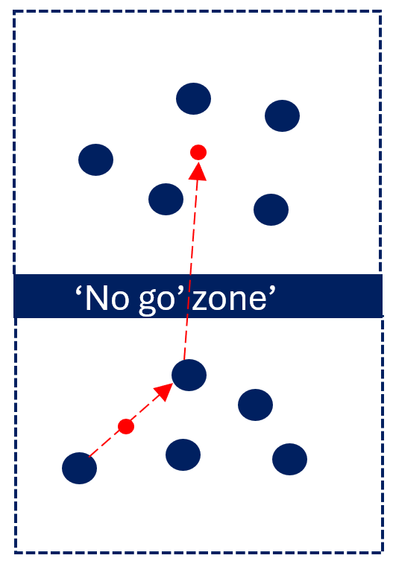
Stage 2 – Term 1
Syllabus content: Move and adjust the body to catch balls and objects of various shapes and sizes
Throw underarm or overarm towards a target at different levels with control
Figure 6: Mini Newcombe ball
Students throw a ball into the opponent's square. Students protect their square by catching the ball (replicating elements of volleyball).
Key
Object and direction
Team X
Team Y
Boundary markers - - - - - -
- - - - - - - - - - - - - - - - - - - - - -- - - - - -
Figure 6: Physical activity or game set up and student positioning
Notes:
Image long description (Key): Under the heading ‘Key’, is a list of 4 items:
The first label reads ‘Object and direction’; next to it is a circle shaded red, with a red arrow extending outwards to the right.
The second label reads ‘Team X’; next to it is a circle shaded blue, with a green stripe running through it diagonally.
The third label reads ‘Team Y’; next to it is a circle shaded blue.
The fourth label reads ‘Boundary markers’; next to it is a dashed line.
Image long description (Figure 6): A white rectangular background is divided in half by a dashed line. This line runs vertically from the top edge to the bottom edge of the diagram. In the left half, there are 5 blue circles, each with a green stripe running diagonally through them, arranged in a loose cluster. On the right side, there are 5 blue circles, also arranged in a cluster. A red circle appears between 2 blue circles in the right half. An arrow runs through the red circle, from one blue circle to another in the centre. A second red arrow runs from the blue circle in the centre, across the dashed line, pointing to a second red circle in the left half.

Slide 62
Stage 2 – Term 7
Cooperate and communicate for teamwork in physical activities
Demonstrate skills and strategies in target, net and court, striking and fielding, territory games and modified sport
Participate in Aboriginal and/or Torres Strait Islander games and activities and identify the Cultural connections
Demonstrate and describe how roles in teams contribute to team goals
Sample physical activity and game | Focus FMS: Consolidating fundamental movement skills improves health and wellbeing
1. Strike it! | Strike using an implement to propel an object over various distances and towards a target
2. Cricket hit and run | Strike using an implement to propel an object over various distances and towards a target
3. Wana Wana | Strike using an implement to propel an object over various distances and towards a target
4. Kangaroo Relay | Apply static and dynamic balances at different levels

Slide 63
Stage 2 – Term 7
Syllabus content: Strike using an implement to propel an object over various distances and towards a target
Game 1: Strike it!
Students strikes objects off a tee towards a variety of targets (replicating elements of tee-ball).
Game instructions
Spread small groups of students (approximately 3-6) out in a wide playing area.
Students take turns to be the striker and strike the object or ball off the tee towards targets. Other students are the fielders and keep count for the striker.
Place 3 or more targets at various distances approximately 2 to 3 metres away from the tee.
The striker aims to strike 3 balls or objects off the tee, aiming to reach the targets. Each time the ball or object hits a target, the striker scores a point.
The striker hits all balls or objects from the tee before swapping positions.
Suggested variations to the game
Use targets of various heights.
Vary the striking equipment e.g. plastic tee-ball bat, racquet.
Use a witches hat as the tee.
Vary the distance of the targets or move the target further away each time a point is scored.
Teachers can apply adjustments to support the development of the strike. Teachers can use the fundamental movement skills content in combination with complementary content to meet the needs of some students with physical disability.
Suggested vocabulary: retrieve, fielders, rotate, contact, stable
Equipment per pair: tee-ball bat or racquet, small ball, tee-ball stand or witches hats, targets
Two-handed strike (tee) Right-handed example
Stand side-on to target
Eyes focus on the ball throughout the strike
Hands next to each other, dominant hand near the base of the bat
Steps towards target with front foot
Hips then shoulders rotate forward
Ball contact made on front foot with straight arms
Follows through with bat around the body

Slide 64
Stage 2 – Term 7
Syllabus content: Strike using an implement to propel an object over various distances and towards a target
Game 2: Cricket hit and run
Students strike an object from a cone and run around markers to score points (replicating elements of cricket).
Game instructions
Set up playing zones for groups of 5 to 6 students.
Each playing zone consists of a ball sitting on top of a cone or a tee and with 2 marker cones placed approximately 5 metres away in triangle shape to mark a ‘hitting zone’ (see Figure 7).
Place a marker 10 metres to the left and one 10 metres to the right of the striking cone or tee.
Students strike the ball with a racquet or a cricket bat into the field. The striker then runs between the markers on the left and right to score a point each time they pass the batting cone.
Once the ball has been retrieved, the fielders must pass the ball between themselves, so that every fielder catches and throws the ball. When the last player catches the ball, the fielders yell ‘stop’, holds the ball in the air, and the striker counts their runs.
Rotate through striker and fielding positions.
Suggested variations to the game
Vary the number of fielders in each group, the distance of the running cones, or size of the ball or object.
Teachers can apply adjustments to support the development of the underarm and overarm throw. Teachers can use the fundamental movement skills content in combination with complementary content to meet the needs of some students with physical disability.
Suggested vocabulary: dominant, retrieve, rotate, stable
Equipment per group: ball, 5 cones or markers, tee, racquet or cricket bat
Two handed strike (cricket) Right-handed example
Stand side-on to target
Eyes focus on the ball throughout the strike
Hands next to each other, dominant hand near the base of the bat
Steps towards target with front foot
Hips then shoulders rotate forward
Ball contact made on front foot with straight arms
Follows through with bat around the body

Slide 65
Stage 2 – Term 7
Syllabus content: Strike using an implement to propel an object over various distances and towards a target
Figure 7: Cricket hit and run
Students strike an object from a cone and run around markers to score points (replicating elements of cricket).
Key
Object and direction
Striker and direction
Fielders
Markers
Figure 7: Physical activity or game set up and student positioning
Notes:
Image long description (Key): Under the heading ‘Key’, is a list of 4 items:
The first label reads ‘Object and direction’; next to it is a circle shaded red, with a red arrow extending outwards to the right.
The second label reads ‘Striker and direction’; next to it is a circle shaded blue, with a green stripe running through it diagonally. An arrow extends outward to the right.
The third label reads ‘Fielders’; next to it is a circle shaded blue.
The fourth label reads ‘Markers’; next to it is a triangle shaded green.
Image long description (Figure 7): Six blue circles are grouped across the top of a white square background in a loose, uneven pattern. Three green triangles are evenly spaced across the bottom of the diagram. A blue circle, with a green strip running through it diagonally, partially overlaps the triangle in the centre. Running through the circle is a solid line with arrows at either end. At the apex of the triangle, is a small red circle, with an arrow extending straight up, pointing towards the circles grouped at the top of the page.

Slide 66
Stage 2 – Term 7
Syllabus content: Strike using an implement to propel an object over various distances and towards a target
Game 3: Wana Wana
This is a version of a game played by the young Noongar girls in the southwest of Western Australia. Students use their Wana (digging stick) or bat to strike to the ball to their teammates to catch.
Game instructions
Divide the class into groups of 6. Each group forms a circle with one player in the centre as the batter.
Each player in the circle faces into the batter and takes turns underarm throwing a ball to the middle batter. The batter hits the ball to the player on the thrower's left.
If the ball is caught, then play continues around the circle.
Once all students in the group have thrown the ball to the batter the game ends and a new student moves to the middle of the circle and the game recommences.
Suggested variations to the game
Vary the number, type and size of balls per group.
Allow one bounce before catch
The batter can hit the ball to any player, not just the student on the thrower's left.
Teachers can apply adjustments to support the development of the underarm and overarm throw. Teachers can use the fundamental movement skills content in combination with complementary content to meet the needs of some students with physical disability.
Suggested vocabulary: strike, dominant, rotate, contact, stable, Noongar, Wana
Equipment per group: ball or object, cones, cricket bat
Two handed strike (cricket) right-handed example
Stand side-on to target
Eyes focus on the ball throughout the strike
Hands next to each other, dominant hand near the base of the bat
Steps towards target with front foot
Hips then shoulders rotate forward
Ball contact made on front foot with straight arms
Follows through with bat around the body
The icon represents the Cultural wellbeing, identity, belonging, kinship, connection and Community. The child is at the centre of Cultural wellbeing and supported by their mob. The beige wavy line represents kinship which is an interconnecting bond that is strong. The outer ochre circle represents the diverse Communities a child may belong to. Artwork by Paige Coe

Slide 67
Stage 2 – Term 7
Syllabus content: Apply static and dynamic balances at different levels
Game 4: Kangaroo relay
Students perform dynamic and static balances in a relay.
Game instructions
Students are grouped into teams of 5 to 6 and are positioned in a line at a cone or marker, one in front of the other with a space in between.
On the teachers call, all students perform a static balance and the student at back of the line weaves between their team members in the line by hopping to reach the front. When the student reaches the front of the line, that student performs 5-star jumps, and then performs a static balance. The student then calls ’Go’ to signal the player at the back of the line to continue the relay, completing the same routine.
To signal that group have completed the relay, the group perform a dynamic balance, such as a tuck sit (sitting, knees tucked towards chest, balancing on buttocks and arms stretched forward to balance).
Suggested variations to the game
  Students can frog hop (in a squat position with hands on the ground, jump forward, landing softly on the balls of the feet) or lunge (stepping forward with one foot, lower body until back knee almost touches the ground) to weave through team members.
  Introduce a front support hold (arms straight with elbows fully extended in push up position), a V-sit hold (sitting with torso and legs off the ground in a V angle) or a standing star shape (feet shoulder-width apart, stretch arms and legs out to the side).
  Teachers can apply adjustments to support the development of the underarm and overarm throw. Teachers can use the fundamental movement skills content in combination with complementary content to meet the needs of some students with physical disability.
  Suggested vocabulary: balance, buttocks, stable, static, dynamic, torso, weave, tuck
  Equipment per group: cone or marker
Static balance
Support leg still, foot flat on the ground
Standing still with non-support leg bent, not touching the support leg
Head stable, eyes focus forward
Torso stable and upright
No excessive arm movements

Slide 68
Stage 3
The sample physical activities and games described here align to the K–6 Sample whole-school curriculum plan.
Overarm throw
Underarm throw
Term 2
Term 7
Kick
Catch

Slide 69
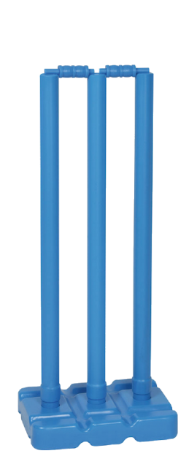
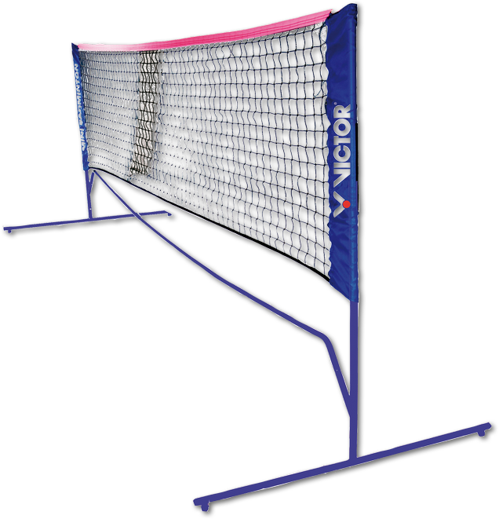
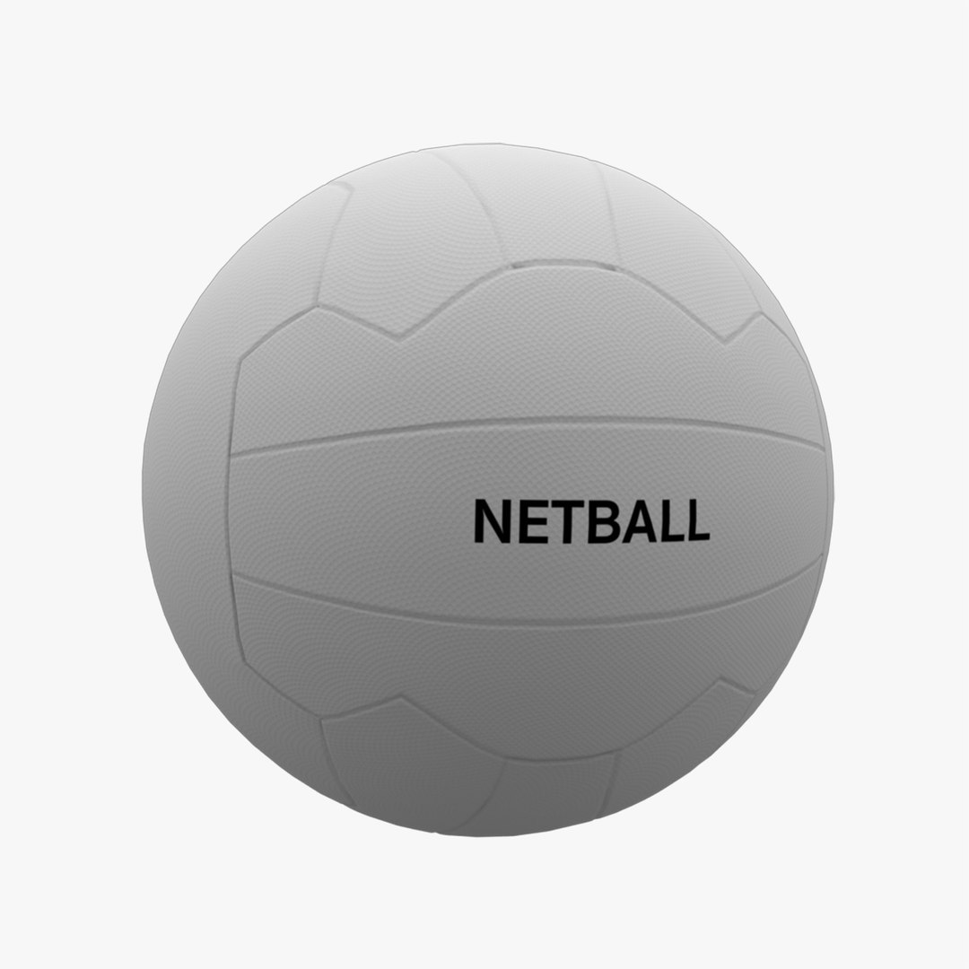
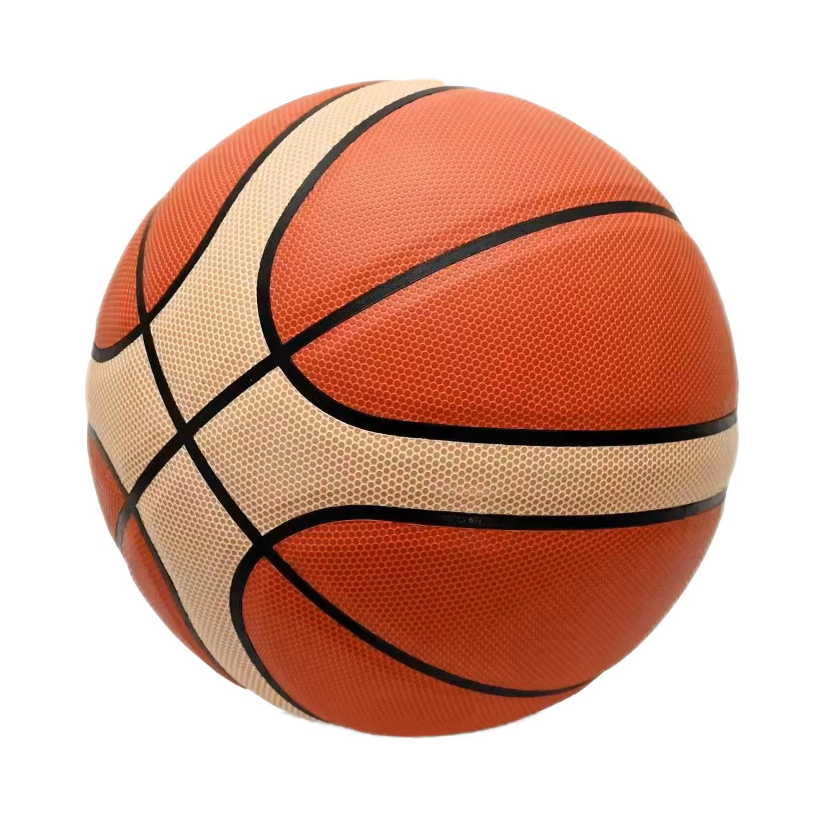
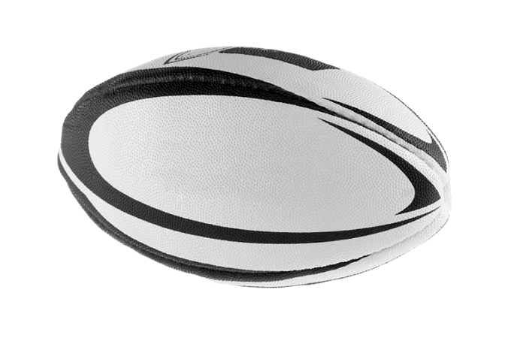
Recommended equipment list for Stage 3
These recommended resources are used in the sample physical activities and games.
Teachers should regularly inspect equipment to ensure it is in good working order. The equipment quantities are approximations as schools make decisions
about resourcing based on class size and student numbers.
Braids/bibs (26–30)
Portable and adjustable net (6–8)
Markers/cones (26–30)
Bean bags (20–30)
Cricket wickets (2)
Cricket bats (2)
Small, bouncy balls (2–6)
Hoops (2)
Soccer balls (15–30)
Basketballs (6–8)
Netballs (6–8)
Touch footballs (3–6)
Medium size soft balls (5–6)
Portable and adjustable net
Cricket bat and wicket
Medium size soft ball
Netball
Basketball
Touch football

Slide 70
Stage 3 – Term 2
Create, communicate and collaborate in physical activities
Participate in and explain how regular and frequent physical activity enhances fitness and wellbeing
Refine and apply skills and strategies in target, net and court, striking and fielding, and territory games and sport
Investigate and engage in physical activities to increase enjoyment and motivation to be physically active in the community
Sample physical activity and game | Focus FMS: Refining fundamental movement skills enhances health and wellbeing
1. 5 pass | Catch to maintain possession or gain advantage in games and sport Throw underarm or overarm to maintain possession or gain advantage in games and sport
2. Mini volleyball | Catch to maintain possession or gain advantage in games and sport Throw underarm or overarm to maintain possession or gain advantage in games and sport
3. End ball | Catch to maintain possession or gain advantage in games and sport Throw underarm or overarm to maintain possession or gain advantage in games and sport
4. Tag ball | Catch to maintain possession or gain advantage in games and sport Throw underarm or overarm to maintain possession or gain advantage in games and sport

Slide 71
Stage 3 – Term 2
Syllabus content: Catch to maintain possession or gain advantage in games and sport
Throw underarm or overarm to maintain possession or gain advantage in games and sport
Game 1: 5 pass
Catch
Eyes focus on the object throughout the catch
Feet move to place the body in line with the object
Hands move to meet the object
Hands and fingers relaxed and slightly cupped
Catch and control the object with hands only (well-timed closure)
Bend elbows to absorb the force of the object
Each team aims to maintain or gain advantage of the ball to score goals (replicating elements of basketball and netball).
Game instructions
Create groups of approximately 6 students (3 versus 3). For each group, set up a playing space, approximately 10 metres by 10 metres with a hoop or a crate as the goal (see Figure 8).
One team starts with the ball and makes 5 or more consecutive passes before aiming to put the ball in the goal. Bounce passes are allowed.
The other team may block or intercept the passes, maintaining a safe distance between team players. If the ball is intercepted, possession is given to the other team .
Suggested variations to the game
  Vary the size of the playing area, the number of team numbers per group.
  Include a time allocation for each round.
  Throw and catch a different object.
  Teachers can apply adjustments to support the development of the underarm and overarm throw and catch. Teachers can use the fundamental movement skills content in combination with complementary content to meet the needs of some students with physical disability.
Suggested vocabulary: defend, attack, intercept, possession, consecutive
Equipment per group: Bibs or sashes, one ball, hoop or crate, cones
Underarm
Eyes focus on target throughout the throw
Shoulders and hip facing towards target
Step towards target with foot opposite throwing arm
Throwing arm follows through past hip and away from the body
Overarm
Eyes focus on target throughout the throw
Stand side-on to target
Throwing arm moves in a downward and backward arc
Step towards target with foot opposite throwing arm
Hips then shoulders rotate
Throwing arm follows through, down and across the body

Slide 72
Stage 3 - Term 2
Syllabus content: Catch to maintain possession or gain advantage in games and sport
Throw underarm or overarm to maintain possession or gain advantage in games and sport
Figure 8: 5 pass
Each team aims to maintain or gain advantage of the ball to score goals (replicating elements of basketball and netball).
Key
Team X
Team Y
Ball
Hoop or crate
Figure 8: Physical activity or game set up and student positioning
Notes:
Image long description (Key): Under the heading ‘Key’, is a list of 4 items:
The first label reads ‘Team X’; next to it is a circle shaded blue, with a green stripe running through it diagonally.
The second label reads ‘Team Y’; next to it is a circle shaded blue.
The third label reads ‘Ball’; next to it is a circle shaded red.
The fourth label reads ‘Hoop or crate’; next to it is the outline of an empty circle, not shaded.
Image long description (Figure 8): Seven circles are arranged loosely across a white square. Five of the circles are shaded blue, and 2 of these have a diagonal green stripe across them. One small red circle is positioned near the top left, slightly overlapping a blue circle. In the bottom left corner is an empty circle.

Slide 73
Stage 3 – Term 2
Syllabus content: Catch to maintain possession or gain advantage in games and sport
Throw underarm or overarm to maintain possession or gain advantage in games and sport
Game 2: Mini volleyball
Catch
Eyes focus on the object throughout the catch
Feet move to place the body in line with the object
Hands move to meet the object
Hands and fingers relaxed and slightly cupped
Catch and control the object with hands only (well-timed closure)
Bend elbows to absorb the force of the object
Students throw a ball over the net into the opponent's (replicating elements of volleyball).
Game instructions
Create groups of approximately 6 (3 versus 3). Set up a court for each group, approximately 10 metres by 10 metres with a net in the middle dividing the court into two (see Figure 9).
Students throw the ball overarm or underarm over the net into the opposition's court (similar to volleyball). The aim is for the ball to hit the ground before it is caught by the opposition.
If the ball crosses the court boundaries or bounces in the oppositions court before it is caught, the other team scores a point.
Suggested variations to the game
Vary the number or ball size or type, number of players per court, size of the court space, net height, number of bounces allowed.
Teachers can apply adjustments to support the development of the underarm and overarm throw and catch. Teachers can use the fundamental movement skills content in combination with complementary content to meet the needs of some students with physical disability.
Suggested vocabulary: court, opponents, serve, boundaries, absorb, control
Equipment per group: cones, soft mid-sized ball, net
Underarm
Shoulders and hip facing towards target
Eyes focus on target throughout the throw
Steps towards target with foot opposite throwing arm
Throwing arm follows through past hip and away from the body
Overarm
Eyes focus on target throughout the throw
Stand side-on to target
Throwing arm moves in a downward and backward arc
Step towards target with foot opposite throwing arm
Hips then shoulders rotate
Throwing arm follows through, down and across the body

Slide 74

Stage 3 – Term 2
Syllabus content: Catch to maintain possession or gain advantage in games and sport
Throw underarm or overarm to maintain possession or gain advantage in games and sport
Figure 9: Mini volleyball
Students throw a ball into their opponent's court to score a point (replicating elements of volleyball).
Key
Object and direction
Team X
Team Y
Net
net
Figure 9: Physical activity or game set up and student positioning
Notes:
Image long description (Key): Under the heading ‘Key’, is a list of 4 items:
The first label reads ‘Object and direction’; next to it is a circle shaded red, with a red arrow extending outwards to the right.
The second label reads ‘Team X’; next to it is a circle shaded blue, with a green stripe running through it diagonally.
The third label reads ‘Team Y’; next to it is a circle shaded blue.
The fourth label reads ‘Net’; next to it is a blurred blue line.
Image long description (Figure 9): A white rectangular background is divided in half by a blurred blue line labelled ‘net’ at the bottom. This line runs vertically from the top edge to the bottom edge of the diagram. In the left half, there are 3 blue circles with diagonal green stripes. One of these circles is positioned near the bottom left corner. A small red circle is positioned next to it. A red arrow extends from the red circle, pointing diagonally upward and to the right, crossing over the net towards the opposite side. On the right side of the net, there are 3 blue circles arranged in a scattered pattern.

Slide 75
Stage 3 – Term 2
Syllabus content: Catch to maintain possession or gain advantage in games and sport
Throw underarm or overarm to maintain possession or gain advantage in games and sport
Game 3: End ball
Catch
Eyes focus on the object throughout the catch
Feet move to place the body in line with the object
Hands move to meet the object
Hands and fingers relaxed and slightly cupped
Catch and control the object with hands only (well-timed closure)
Bend elbows to absorb the force of the object
Students throw a mid-sized ball past Blockers to team players in an end zone (replicating elements of netball and basketball).
Game instructions
Set up a court approximately 15 metres by 15 metres with a zone for Blockers (in the middle) and 2 End zones. Divide the class into 2 equal teams with one team as Blockers with bibs on and the other team split between the End zones.
The aim is for the End zone students to underarm or overarm throw a mid-sized ball to a teammate standing in the other End zone (see Figure 10).
Bounce passes are allowed. The Blockers attempt to intercept the ball before it reaches the end zone. No physical contact is allowed. If a Blocker catches or touches the ball thrown from an end zone player, they swap places with the student who threw it.
Suggested variations to the game
  Vary the Blocker zone size, or numbers in each team.
  Include a time allocation for each round.
  Replace the ball with a different object.
  Vary the number of balls in the game.
  Teachers can apply adjustments to support the development of the underarm and overarm throw, and catch. Teachers can use the fundamental movement skills content in combination with complementary content to meet the needs of some students with physical disability.
  Suggested vocabulary: intercept, possession, defenders, attackers, pivot, zone, absorb, control
Equipment: bibs or sashes, mid-sized balls, cones
Underarm
Shoulders and hip facing towards target
Eyes focus on target throughout the throw
Steps towards target with foot opposite throwing arm
Throwing arm follows through past hip and away from the body
Overarm
Eyes focus on target throughout the throw
Stand side-on to target
Throwing arm moves in a downward and backward arc
Step towards target with foot opposite throwing arm
Hips then shoulders rotate
Throwing arm follows through, down and across the body

Slide 76
Stage 3 – Term 2
Syllabus content: Catch to maintain possession or gain advantage in games and sport
Throw underarm or overarm to maintain possession or gain advantage in games and sport
Figure 10: End ball
Students throw a mid-sized ball past defenders to team players in an end zone resembling the game ‘piggy in the middle’ (replicating elements of netball).
Key
Ball and direction
Blockers
Team Y
Markers - - - - - - -
- - - - - - - - - - - - - - - - - - - - - - - - - - - - - - - - - - - - - - - -
- - - - - - - - - - - - - - - - - - - - - - - - - - - - - - - - - - - - - - - -
End zone
End zone
Figure 10: Physical activity or game set up and student positioning
Notes:
Image long description (Key): Under the heading ‘Key’, is a list of 4 items:
The first label reads ‘Ball and direction’; next to it is a circle shaded red with an arrow extending outwards to the right.
The second label reads ‘Blockers’; next to it is a circle shaded blue, with green stripe running through it diagonally.
The third label reads ‘Team Y; next to it is a circle shaded blue.
The fourth label reads ‘Markers’; next to it is a dashed line.
Image long description (Figure 10): Two dashed lines run from left to right across the top and bottom of a white rectangular field. Above and at the left of the line across the top of the page is the label ‘End zone’. Sitting below the line across the line at the bottom of the page, at the left, is a second label ‘End zone’. There are 3 blue circles positioned in a line in each end zone. A red circle is positioned above each of the blue circles in the middle and left of the bottom end zone, with a red arrow extending upwards and across the middle section of the field. The arrows touch the corresponding blue circles in the end zone at the top of the field. A third red circle is positioned below the blue circle at the top right of the end zone at the top of the field, with an arrow extending downwards across the middle section of the field so that it touches the corresponding blue circle in the end zone at the bottom. Six blue circles with green stripes running through them diagonally are scattered across the middle section of the field, in and between the red arrows.

Slide 77
Stage 3 – Term 2
Syllabus content: Catch to maintain possession or gain advantage in games and sport
Throw underarm or overarm to maintain possession or gain advantage in games and sport
Game 4: Tag ball
Catch
Eyes focus on the object throughout the catch
Feet move to place the body in line with the object
Hands move to meet the object
Hands and fingers relaxed and slightly cupped
Catch and control the object with hands only (well-timed closure)
Bend elbows to absorb the force of the object
Taggers pivot and pass a football to tag players (replicating elements of touch football).
Game instructions
Players spread out in a designated playing area (approximately 10 metres by 10 metres). 2 to 5 students are the taggers (see Figure 11).
On the teachers call or signal, the taggers aim to tag the players by touching them with the football. Taggers can’t run with the ball. They can pivot, pass to another tagger and tag players. They must be in possession of the ball to tag a player. They can run without the ball to improve their position.
All players aim to evade the taggers. If a player is tagged by the football or steps outside of the playing space, they join the tagging team.
As more players become taggers, add more footballs to the game.
Suggested variations to the game
Vary the number, size or type of ball, size of playing space, number of starting taggers.
  Teachers can apply adjustments to support the development of the underarm and overarm throw, and catch. Teachers can use the fundamental movement skills content in combination with complementary content to meet the needs of some students with physical disability.
Suggested vocabulary: defend, intercept, pivot, zone, evade, absorb, control, possession
Equipment per group: 3 to 4 footballs, cones, bibs
Underarm
Shoulders and hip facing towards target
Eyes focus on target throughout the throw
Steps towards target with foot opposite throwing arm
Throwing arm follows through past hip and away from the body
Overarm
Eyes focus on target throughout the throw
Stand side-on to target
Throwing arm moves in a downward and backward arc
Step towards target with foot opposite throwing arm
Hips then shoulders rotate
Throwing arm follows through, down and across the body

Slide 78
Stage 3 – Term 2
4
Syllabus content: Catch to maintain possession or gain advantage in games and sport
Throw underarm or overarm to maintain possession or gain advantage in games and sport
Figure 11: Tag ball
Taggers pivot and pass a football to tag players (replicating elements of touch football).
Key
Football
Tagger
Player
Figure 11: Physical activity or game set up and student positioning
Notes:
Image long description (Key): Under the heading ‘Key’, is a list of 3 items:
The first label reads ‘Football’; next to it is a circle shaded red.
The second label reads ‘Tagger’; next to it is a circle shaded blue, with a green stripe running diagonally across it.
The third label reads ‘Player’; next to it is a circle shaded blue.
Image long description (Figure 11): Fourteen circles are scattered across a white rectangular field. Nine of the circles are shaded blue. Five of the circles are blue with green stripes running diagonally through them. A small red circle is positioned next to 3 of the blue circles with green stripes running through them.

Slide 79
Stage 3 – Term 7
Create, communicate and collaborate in physical activities
Refine and apply skills and strategies in target, net and court, striking and fielding, and territory games and sport
Collaborate to create physically active games, incorporating rules and scoring systems that are fair and inclusive
Investigate physical activity opportunities in Australia that cater for the diverse ways in which people move
Sample physical activity and game | Focus FMS: Refining fundamental movement skills enhances health and wellbeing
1. Rounders | Kick a ball to maintain possession or gain advantage in games and sport
2. Kick cricket | Kick a ball to maintain possession or gain advantage in games and sport
3. Dribble traffic | Kick a ball to maintain possession or gain advantage in games and sport
4. Zone soccer | Kick a ball to maintain possession or gain advantage in games and sport

Slide 80
Stage 3 – Term 7
Syllabus content: Kick a ball to maintain possession or gain advantage in games and sport
Game 1: Rounders
Students kick a ball to collect bean bags. Fielders quickly return the balls to the markers
Game instructions
Set 5 cones 1.5 metres apart with a ball on each. Place 2 hoops approximately 5 metres behind the kickers with 15 plus bean bags. Mark a safety line as a boundary to prevent fielders from standing too close to the kickers (see Figure 12).
Five students are the kickers and all other students are fielders. At the teacher’s signal, all 5 kickers kick their soccer ball strategically into spaces. The kickers then sprint to retrieve one bean bag at a time from the hoop, placing it next to their kicking cone. When each ball is returned by the fielders to the kicking cone, that kicker must stop collecting bean bags. The ball returned to a kicking cone doesn’t necessarily have to be the ball they kicked.
The 5 kickers combine the number of retrieved bean bags for a score. A new group of kickers take their turn.
Suggested variations to the game
Vary the number of kickers, and size or type of balls.
For each ball caught on the full, all 5 kickers must stop collecting bean bags and their round ends.
Teachers can apply adjustments to support the development of the kick. Teachers can use the fundamental movement skills content in combination with complementary content to meet the needs of some students with physical disability.
Suggested vocabulary: retrieve, fielders, tally, instep
Equipment: 5 soccer balls, markers, 5 kicking cones, 1 hoop, 20 plus bean bags
Kick
Eyes focus on the ball throughout the kick
Forward and sideward swing of arm opposite to kicking leg
Non-kicking foot placed near the ball
Bends knee of kicking leg at least 90 degrees during the back-swing
Contact with ball with top of the foot (a ‘shoelace’ kick) or instep
Kicking leg follows through high towards the target

Slide 81
Stage 3 – Term 2
4
Syllabus content: Kick a ball to maintain possession or gain advantage in games and sport
Figure 12: Rounders
Students kick a ball to run and collect beanbags. Fielders quickly return the balls to the markers.
- - - - - - - - - - - - - - - - - - - - - - - - - - - - - - -
Key
Object and direction
Kicker
Fielder
Markers or targets
Hoop with bean bags
safety line
- - - - - - - - - - - - - - - - - - - - - - - - - - - - - - - - - - -
Figure 12: Physical activity or game set up and student positioning
Notes:
Image long description (Key): Under the heading ‘Key’ is a list of 5 items:
The first label reads ‘Object and direction’; next to it is a circle shaded red, with an arrow extending out and pointing to the right.
The second label reads ‘Kicker’; next to it is a circle shaded blue, with a green stripe running through it diagonally. A blue arrow extends out and to the right of the circle.
The third label reads ‘Fielder’; next to it is a circle shaded blue.
The fourth label reads ‘Markers or targets’; next to it is a triangle shaded green with the apex pointing straight up.
The fifth label reads ‘Hoop with bean bags’; next to it is the outline of a circle containing 7 small solid yellow circles inside it.
Image long description (Figure 12): A white rectangular field is divided in half by a dotted line labelled ‘safety line’. Above the line, at the top of the field, 7 blue circles are evenly spaced across the width of the image. Below the safety line, 5 green triangles are arranged in a horizontal line. On top of each green triangle is a red circle with a long red arrow pointing straight upward, across the safety line, towards the blue circles at the top. Below each of the green triangles is a blue circle with a green stripe running diagonally through it. From the 3 circles on the left, a short blue arrow points diagonally downward towards a circle containing 7 small yellow circles clustered inside it. From the 2 blue circles on the right, a short blue arrow points diagonally downward towards another circle containing 7 small yellow circles clustered inside.

Slide 82
Stage 3 – Term 7
Syllabus content: Kick a ball to maintain possession or gain advantage in games and sport
Game 2: Kick cricket
Students kick a moving ball to score runs (replicating elements of cricket)
Game instructions
Set up 2 wickets approximately 4 metres apart. Place a marker 10 metres to the side of each wicket. Place 2 markers approximately 10 metres from the kickers for 2 bowlers who must remain at their marker. Two wicket keepers stand a safe distance behind the wickets. All other students are fielders (see Figure 13).
Two students are the kicking pair. The bowlers starts the game by underarm rolling a medium-sized soft ball at the kicker opposite them. Only when a ball is kicked, that kicker runs around the closest marker to them. Kickers must run if they touch the ball. They may run more than once. If the ball is missed, the ball is returned to the bowler.
The fielders return the balls to the bowlers. The bowler does not have to wait for the kicker to be ready and may bowl at their wicket. Both kickers are out if one of the balls hits either wicket or if the ball is caught on the full.
Rotate all students through the positions.
Suggested variations to the game
Kickers combine the number of runs made to add to the class score.
Vary the size and type of balls and the distance of bowlers or distance to the side markers.
Teachers can apply adjustments to support the development of the kick
Teachers can use the fundamental movement skills content in combination with complementary content to meet the needs of some students with physical disability.
Suggested vocabulary: pass, defenders, goal, instep, bowlers, wicket
Equipment: 2 bats, 2 medium sized soft balls, 6 markers
Kick
Eyes focus on the ball throughout the kick
Forward and sideward swing of arm opposite to kicking leg
Non-kicking foot placed near the ball
Bends knee of kicking leg at least 90 degrees during the back-swing
Contact with ball with top of the foot (a ‘shoelace’ kick) or instep
Kicking leg follows through high towards the target

Slide 83
Stage 3 – Term 2
Syllabus content: Kick a ball to maintain possession or gain advantage in games and sport
Figure 13: Kick cricket
Students kick a moving ball to score runs (replicating elements of cricket)
- - - - - - - - - - - - - - - - - - - - - - - - - - - - - - -
Key
Ball and direction
Kicker and direction
Fielder
Bowler, wicket keeper
Markers
Figure 13: Physical activity or game set up and student positioning
Notes:
Image long description (Key): Under the heading ‘Key’ is a list of 5 items:
The first label reads ‘Ball and direction’; next to it is a circle shaded red, with an arrow extending from it to the right.
The second label reads ‘Kicker and direction’; next to it is a circle shaded blue, with a green stripe running diagonally through it. An arrow extends from it to the right.
The third label reads ‘Fielder’; next to it is a circle shaded blue.
The fourth label reads ‘Bowler, wicket keeper’; next to it is a yellow circle outlined in blue.
The fifth label reads ‘Markers’; next to it is a triangle shaded green.
Image long description (Figure 13): At the top of a white rectangular field there are 7 blue circles evenly spaced across the width of the image. Below this row, 2 yellow circles are positioned close to each other, each sitting on top of a small green triangle. To the left of each circle is a small red circle with a red arrow pointing straight downward. Underneath each of the red arrows are 2 blue circles with a green stripe running diagonally through them. From the left circle, an arrow extends out to the left, pointing towards a small green triangle. From the circle on the right, an arrow extends out to the right, towards another small green triangle. Each of the blue circles with green stripes running diagonally through them sit on the top of 2 large green triangles. Underneath each of the large green triangles sits a yellow circle with a blue outline at the bottom of the field.

Slide 84
Stage 3 – Term 7
Syllabus content: Kick a ball to maintain possession or gain advantage in games and sport
Game 3: Dribble traffic
Students kick dribble a ball across a playing area to retrieve bean bags (replicating elements of soccer).
Game instructions
Set up a large playing area with 2 zones at each end of the playing area. Divide the class into 2 teams and scatter an even amounts of bean bags (16 to 20), in each zone or home base (see Figure 14).
On teacher signal, students dribble the soccer ball to their oppositions zone to pick up and retrieve one bean bag at a time and return it to their zone or home base.
The game finishes when the teacher signals time. Teams count the bean bags now in their zone or home base for a score.
Suggested variations to the game
Vary the size of the playing area.
Students work in pairs, taking turns to retrieve a bean bag.
Students may intercept or kick their oppositions balls outside of the playing area.
  Teachers can apply adjustments to support the development of the kick. Teachers can use the fundamental movement skills content in combination with complementary content to meet the needs of some students with physical disability.
Suggested vocabulary: dribble, defenders, goal, zones, instep, control, opposition
Equipment: markers or cones, one soccer ball per student, bean bags (36 to 40)
Kick
Eyes focus on the ball throughout the kick
Forward and sideward swing of arm opposite to kicking leg
Non-kicking foot placed near the ball
Bends knee of kicking leg at least 90 degrees during the back-swing
Contact with ball with top of the foot (a ‘shoelace’ kick) or instep
Kicking leg follows through high towards the target

Slide 85
Stage 3 – Term 2
Syllabus content: Kick a ball to maintain possession or gain advantage in games and sport
4
- - - - - - - - - - - - - - - - - - - - - - - - - - - -
- - - - - - - - - - - - - - - - - - - - - - - - - - - - -
Figure 14: Dribble traffic
Students kick dribble a ball into their oppositions territory to retrieve bean bags (replicating elements of soccer).
Key
Bean bag
Ball and direction
Team X
Team Y
Markers - - - - - - - - - -
Figure 14: Physical activity or game set up and student positioning
Notes:
Image long description (Key): Under the heading ‘Key’ is a list of 5 items:
The first label reads ‘Bean bag’; next to it is a circle shaded yellow.
The second label reads ‘Ball and direction’; next to it is a circle shaded red, with an arrow extending from it to the right.
The third label reads ‘Team X’; next to it is a circle shaded blue with a green stripe running diagonally.
The fourth label reads ‘Team Y’; next to it is a circle shaded blue.
The fifth label reads ‘Markers’; next to it is a dashed line.
Image long description (Figure 14): On the far left-hand side of a white rectangular filed is a column of yellow circles, evenly spaced. A dashed vertical line runs down the right-hand side of the column of yellow circles, separating them from a column of blue circles, each with a green stripe running diagonally through them. To the right of each of these circles is a small red circle, each with a small arrow extending to the right, towards the centre of the field. On the far right-hand side of the white rectangular filed is a second column of yellow circles, evenly spaced. A dashed vertical line runs down the left-hand side of the column of yellow circles, separating them from a column of blue circles. To the left of each of these circles is a small red circle, each with a small arrow extending to the left, towards the centre of the field. A large unmarked area lies between the arrows and columns on each side.

Slide 86
Stage 3 – Term 7
Syllabus content: Kick a ball to maintain possession or gain advantage in games and sport
Game 4: Zone soccer
Students in zones kick pass, dribble and defend to score goals (replicating elements of soccer).
Game instructions
Mark out a soccer field into 3 zones and divide the class into 2 teams. Each zone has an even number of players from each team (see Figure 15). Start with 1 ball per team, more can be added once students understand the game.
Players cannot cross into other zones. The ball must be kicked and passed to a player of their team in each zone to score a goal at their team’s end. There are no goalkeepers.
Students can intercept and kick their oppositions ball out of the playing area.
If a ball leaves the playing area, the opposing team takes possession from the sideline.
The aim is to score a goal in a short period of time.
Rotate players through different zones.
Once a goal is scored, the game begins again from Zone 2.
Suggested variations to the game
Vary the type of ball, number of balls in play, size of the playing zones or the number of students in each zone.
  Teachers can apply adjustments to support the development of the kick. Teachers can use the fundamental movement skills content in combination with complementary content to meet the needs of some students with physical disability.
Suggested vocabulary: pass, intercept, defenders, goal, zones, instep, control, retrieve
Equipment per field: 2 or more soccer balls, cones, bibs
Kick
Eyes focus on the ball throughout the kick
Forward and sideward swing of arm opposite to kicking leg
Non-kicking foot placed near the ball
Bends knee of kicking leg at least 90 degrees during the back-swing
Contact with ball with top of the foot (a ‘shoelace’ kick) or instep
Kicking leg follows through high towards the target

Slide 87
Stage 3 – Term 7
4
Syllabus content: Kick a ball to maintain possession or gain advantage in games and sport
Figure 15: Zone soccer
- - - - - - - - - - - - - - - - - - - - - - - - - - - - -
- - - - - - - - - - - - - - - - - - - - - - - - - - - - -
Students in zones kick pass, dribble and defend to score goals (replicating elements of soccer).
Key
Team X student
Team Y student
Ball and direction
Markers - - - - - - - - - -
Targets
Zone 1
Zone 2
Zone 3
Figure 15: Physical activity or game set up and student positioning
Notes:
Image long description (Key): Under the heading ‘Key’ is a list of 5 items:
The first label reads ‘Team X student’; next to it is a circle shaded blue, with a green stripe running diagonally through it.
The second label reads ‘Team Y student’; next to it is a circle shaded blue.
The third label reads ‘Ball and direction’; next to it is a circle shaded red, with an arrow extending from it towards the right.
The fourth label reads ‘Markers; next to it is a dashed line.
The fifth label reads ‘Targets’; next to it is a triangle shaded green.
Image long description (Figure 15): Two vertical dashed lines divide a white rectangular field into 3 equal sections. At the bottom of the section on the left is the label ‘Zone 1’; at the bottom of the section in the centre is the label ‘Zone 2’; at the bottom of the section on the right is the label ‘Zone 3’. Scattered in each zone, there are 2 blue circles and 2 blue circles with green stripes running diagonally through them. In zone 2, a small red circle with an arrow extending out and towards the top of the left-hand corner of the page sits next to a blue circle with a green stripe running diagonally through it. In zone 3, another small red circle with an arrow pointing diagonally upward to the right sits next to a blue circle. At the middle of the left and right edges of the field, in zones one and 3, are 2 green triangles.

